Slide 1
MONTH IN REVIEW NOVEMBER 2023
CEO REPORT EUGENE MATTIONI

Slide 2
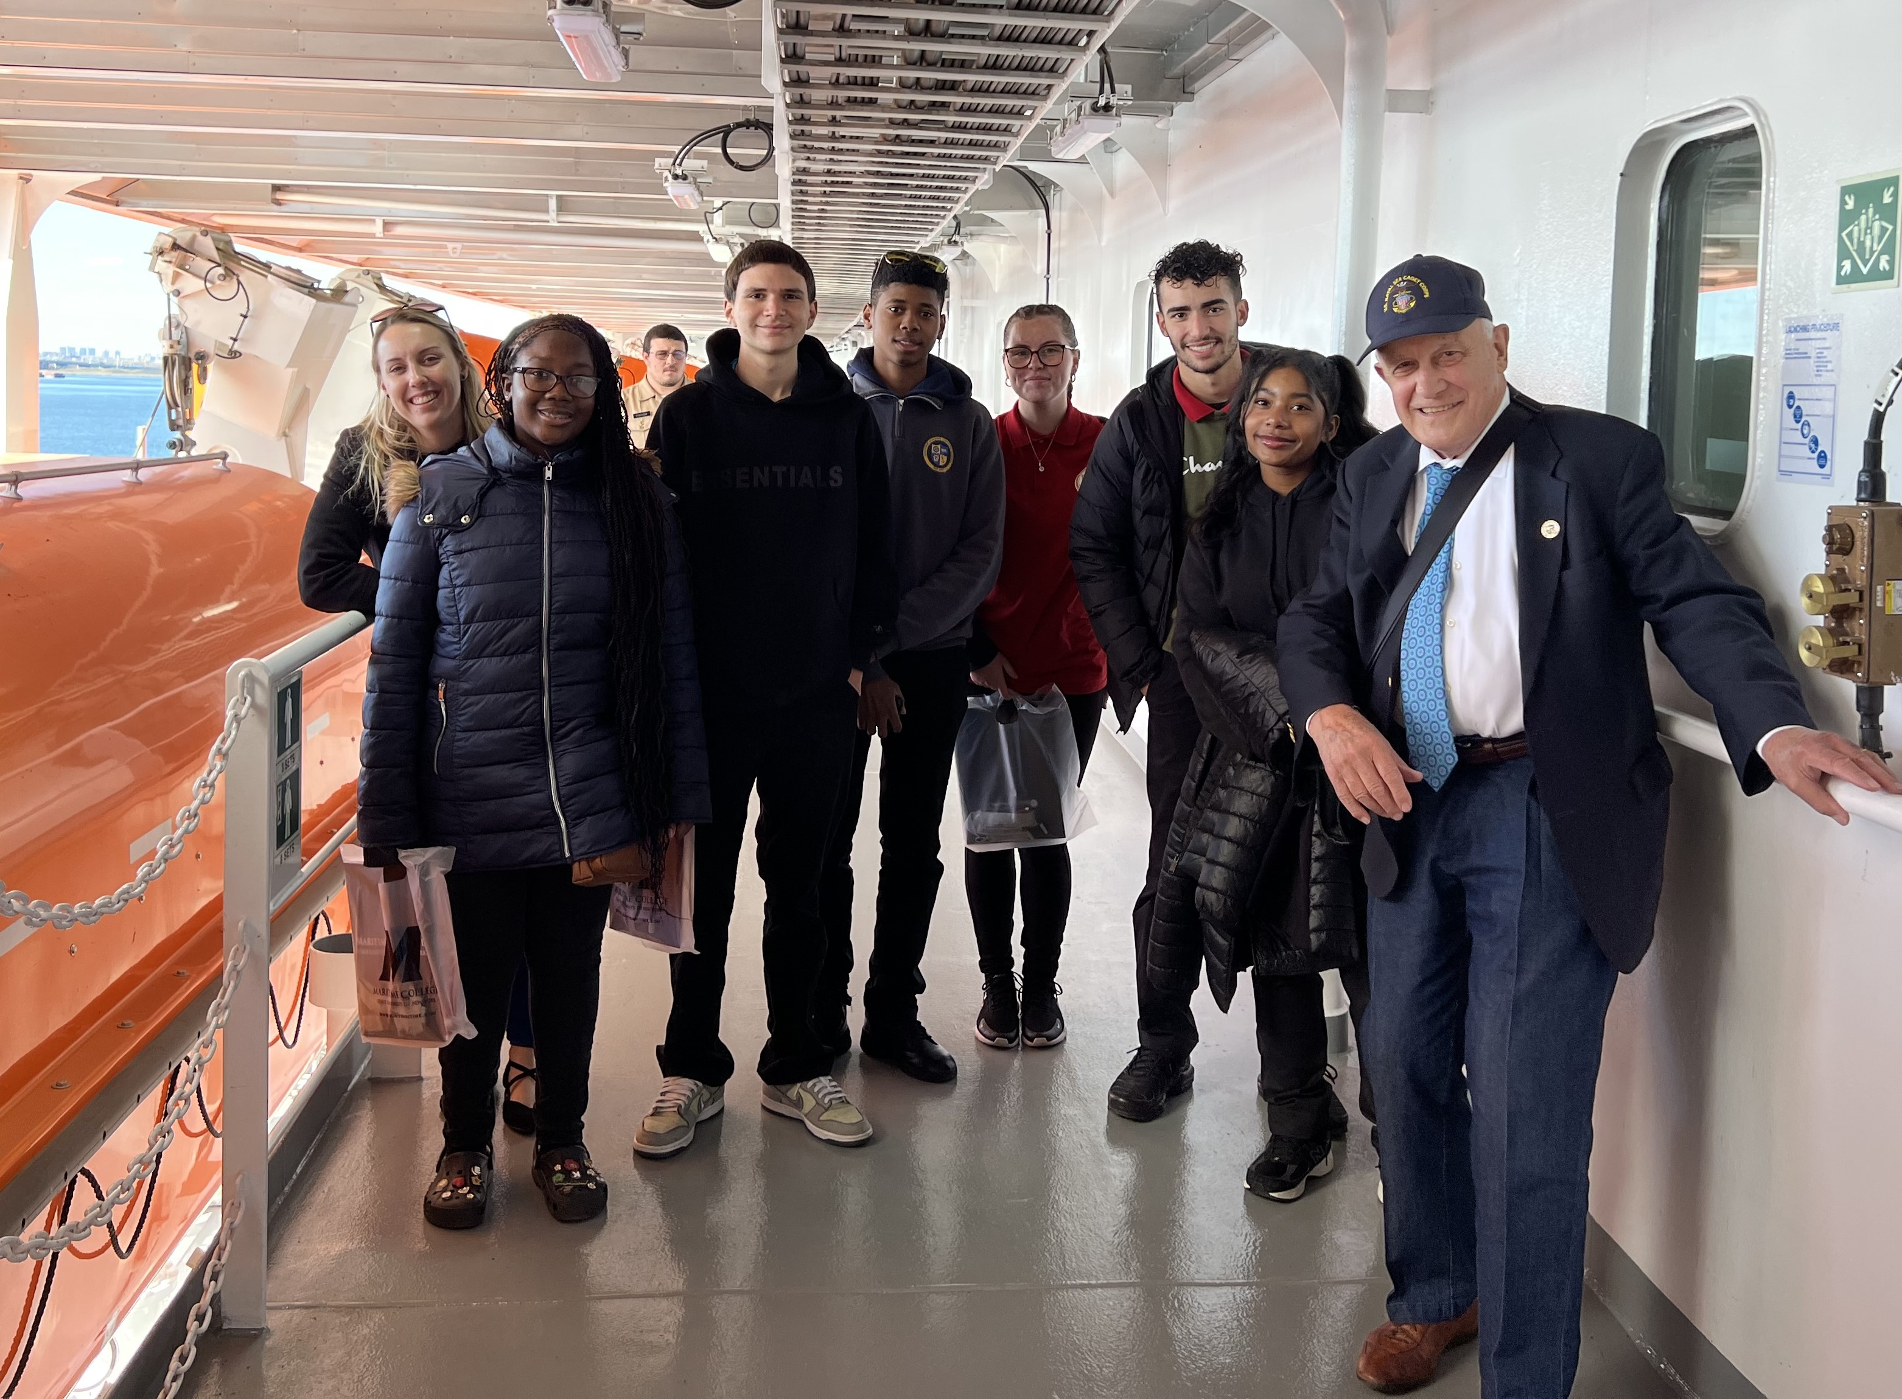
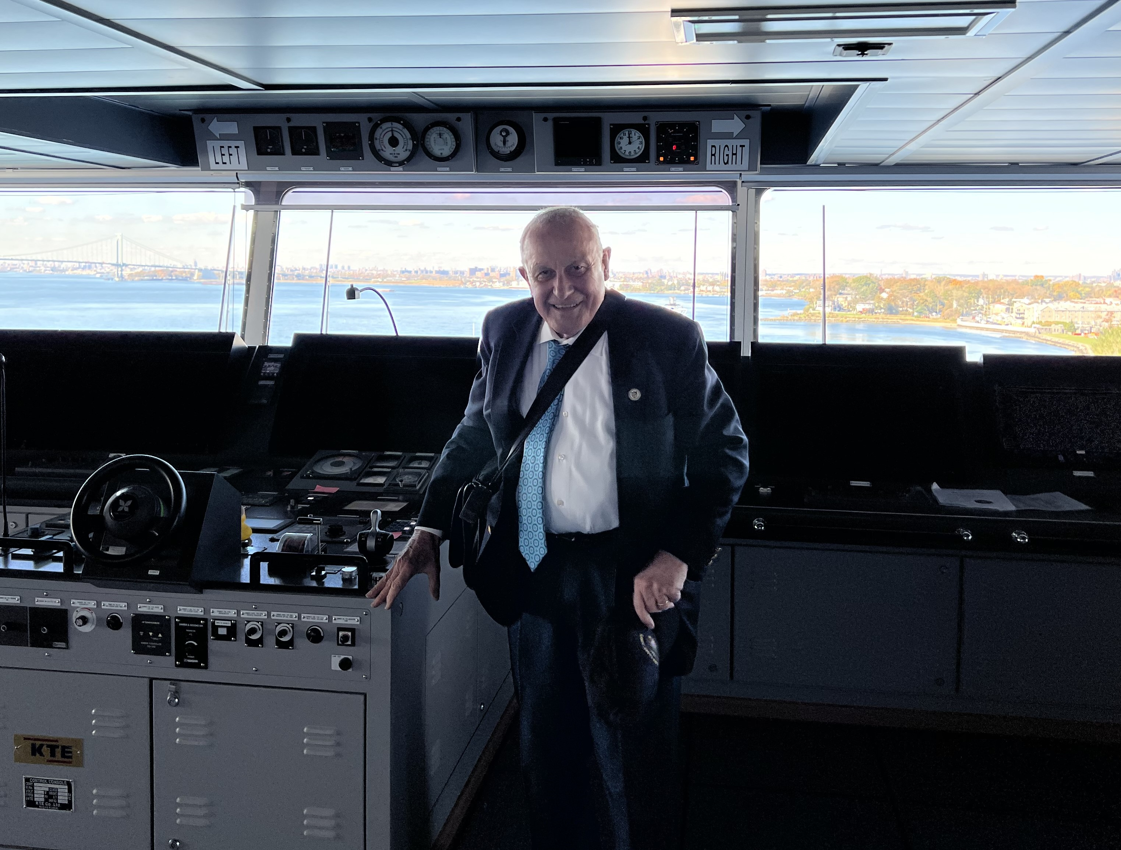
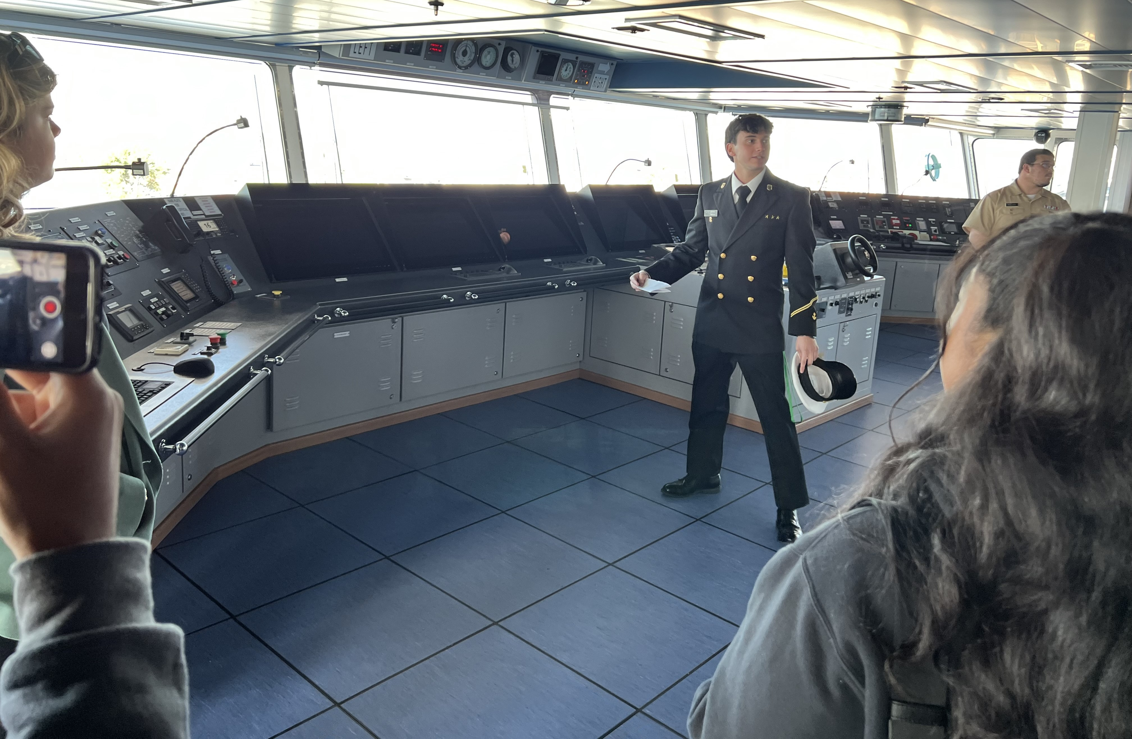
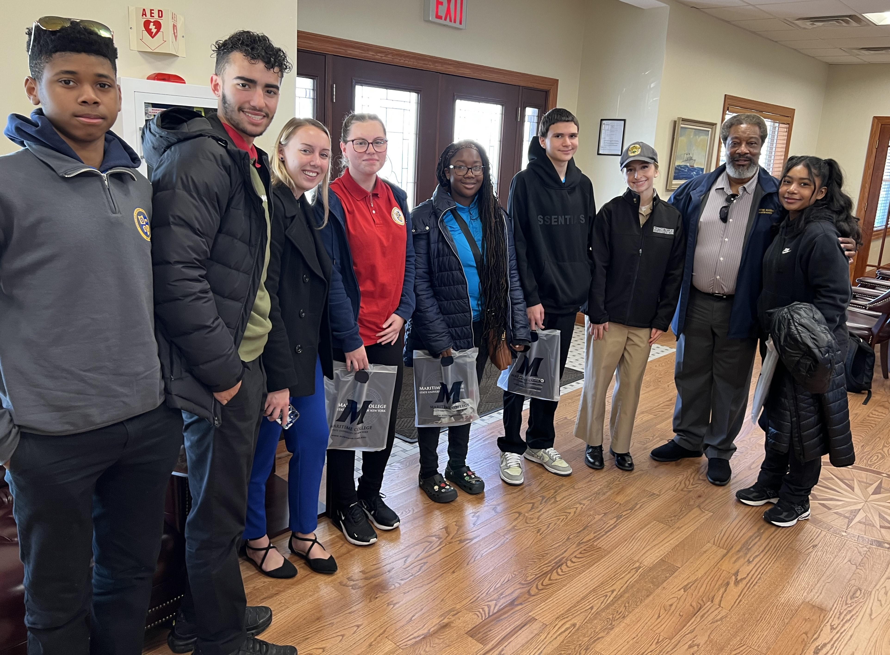
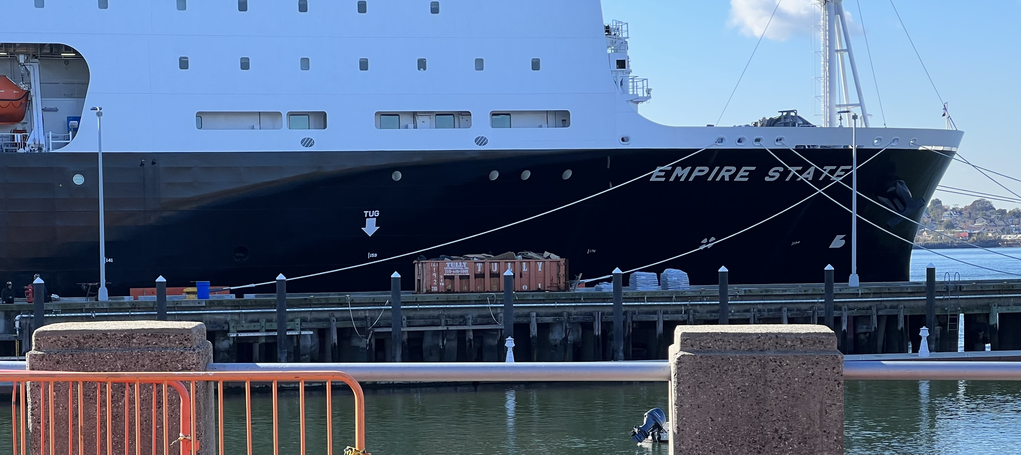
SUNY Campus and Empire State Tour – 11/2/23

Slide 3
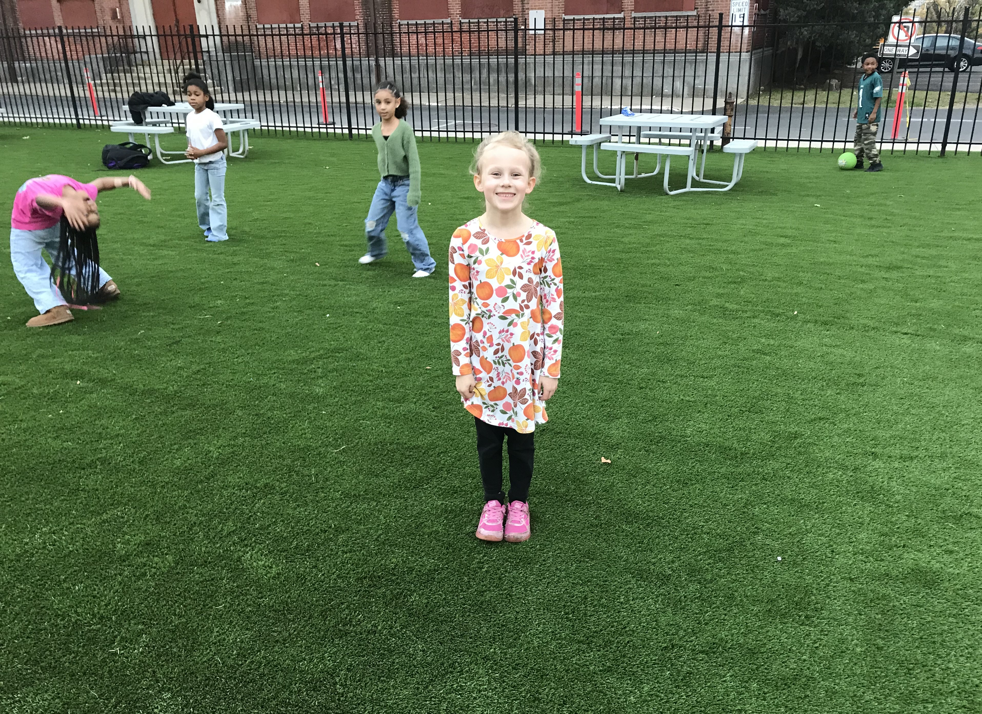
Astroturf Complete – East Yard of Bldg. 107

Slide 4
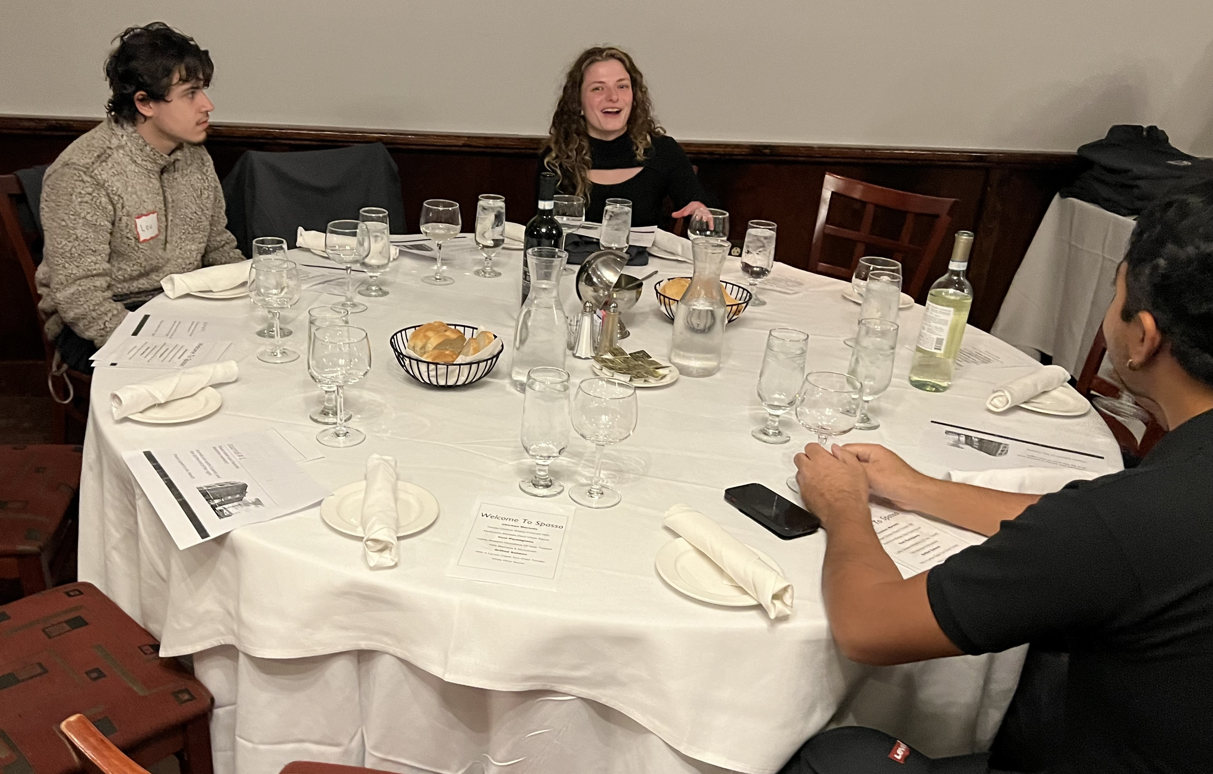
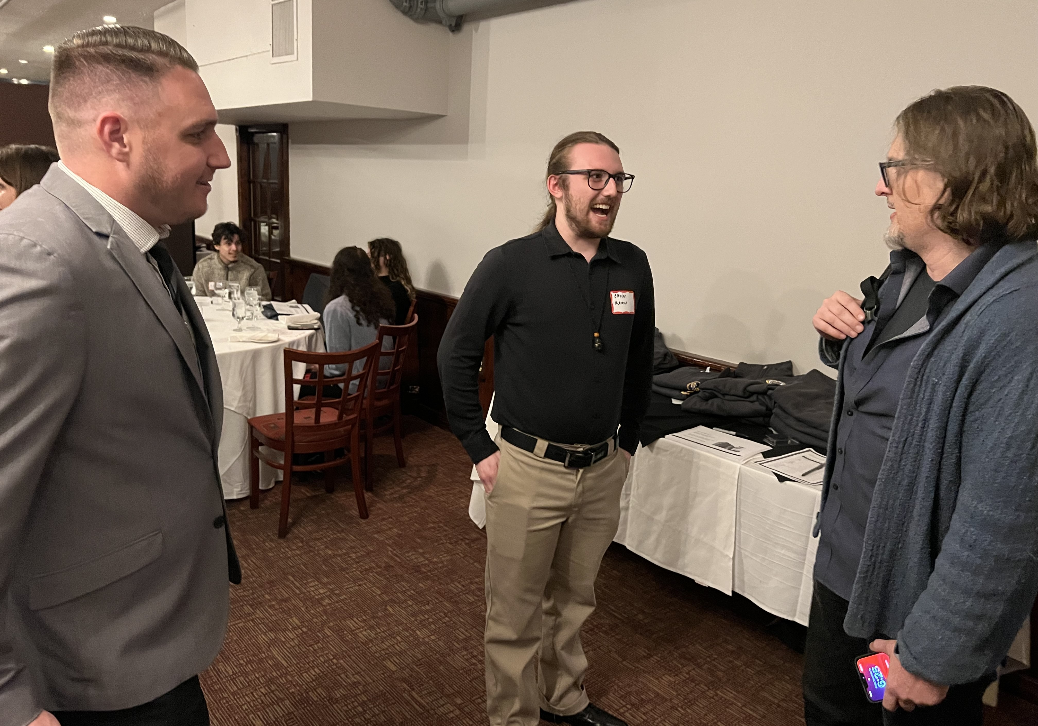
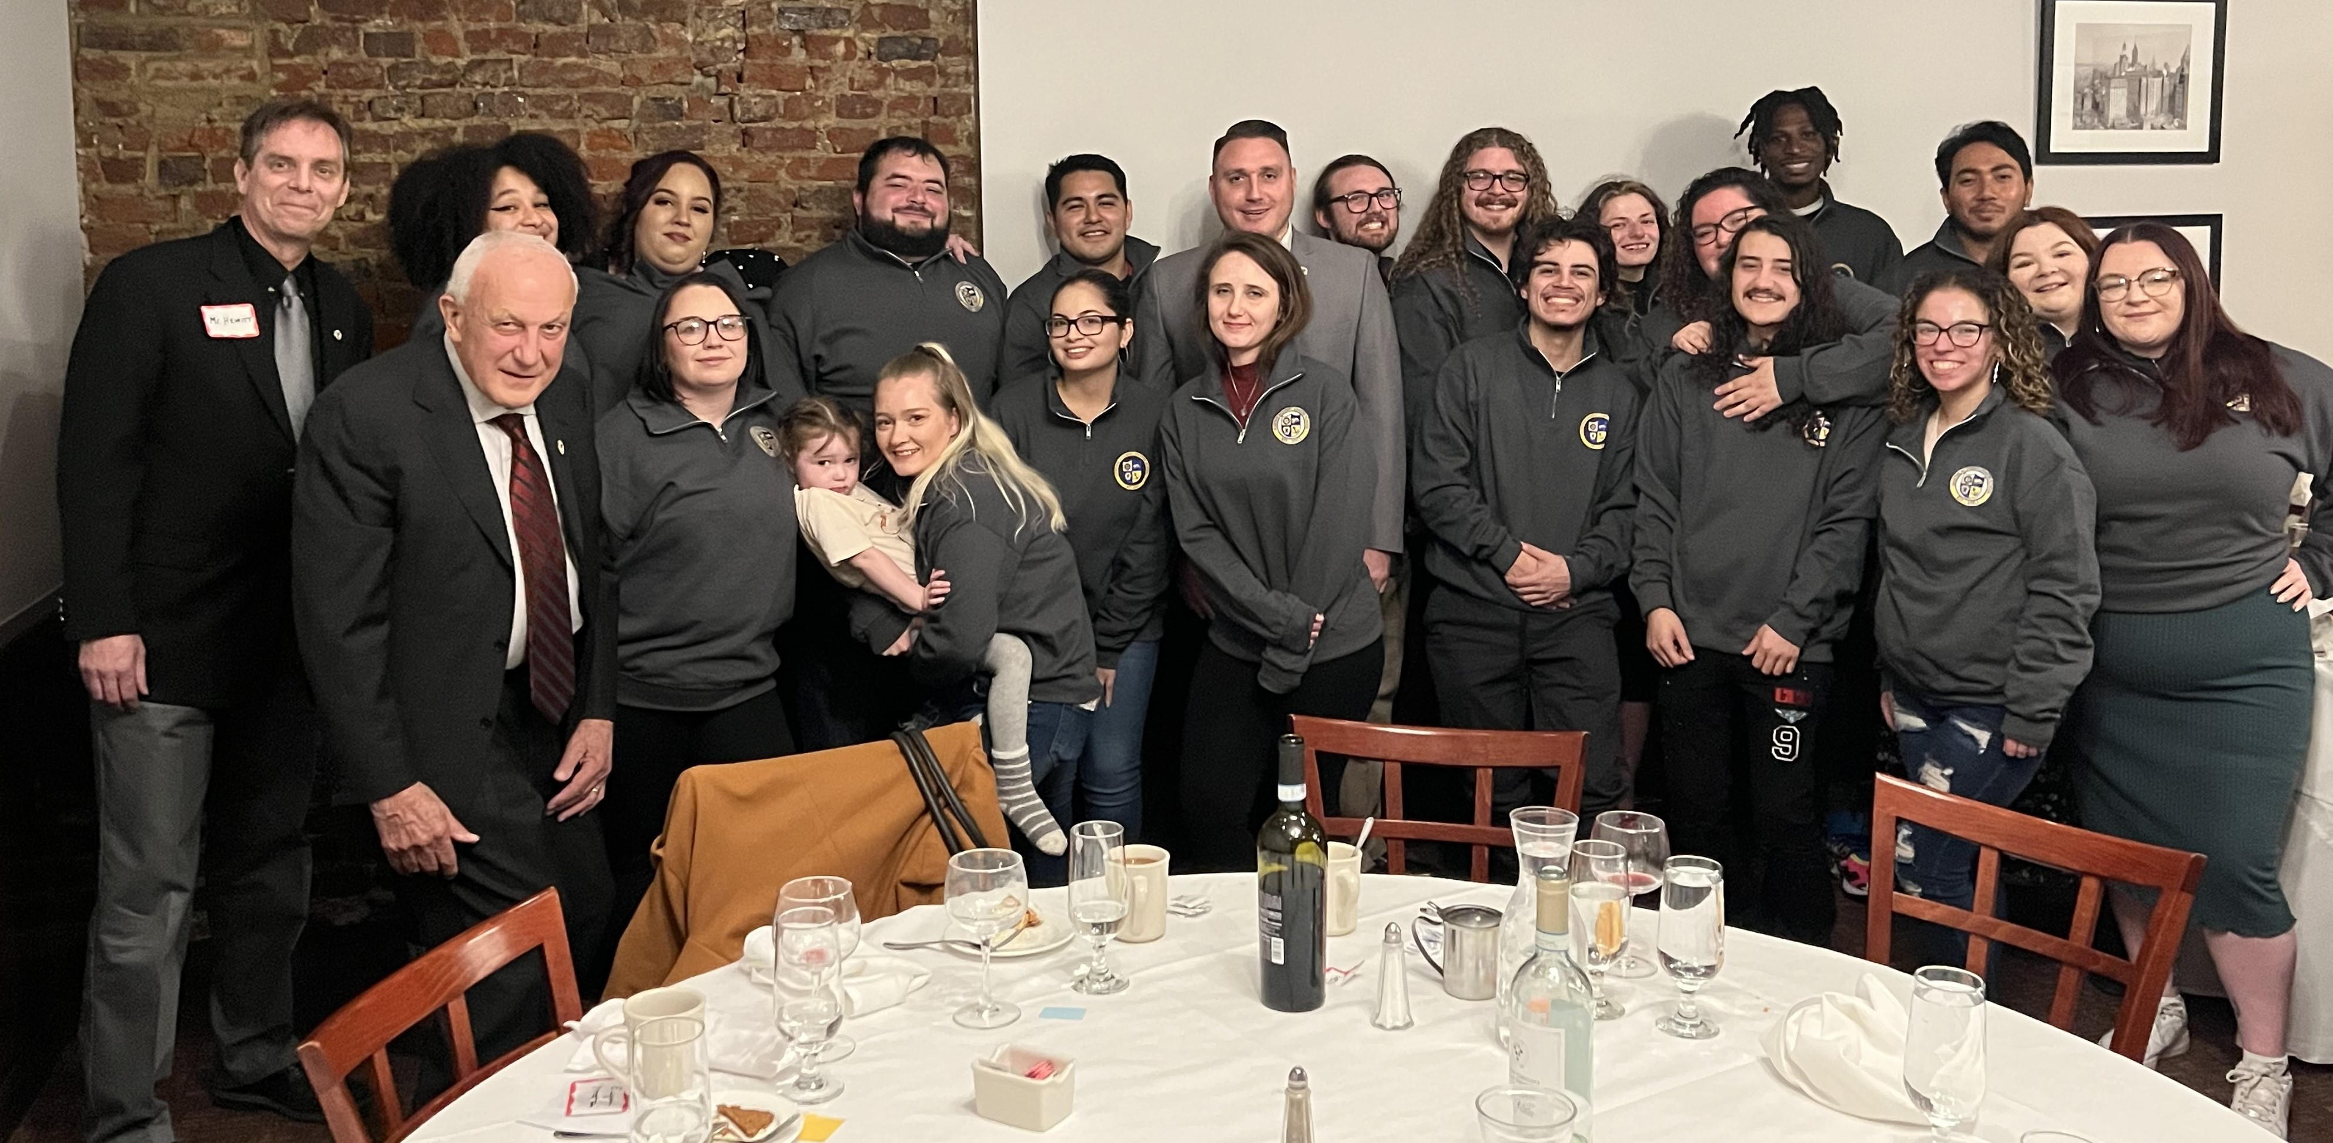
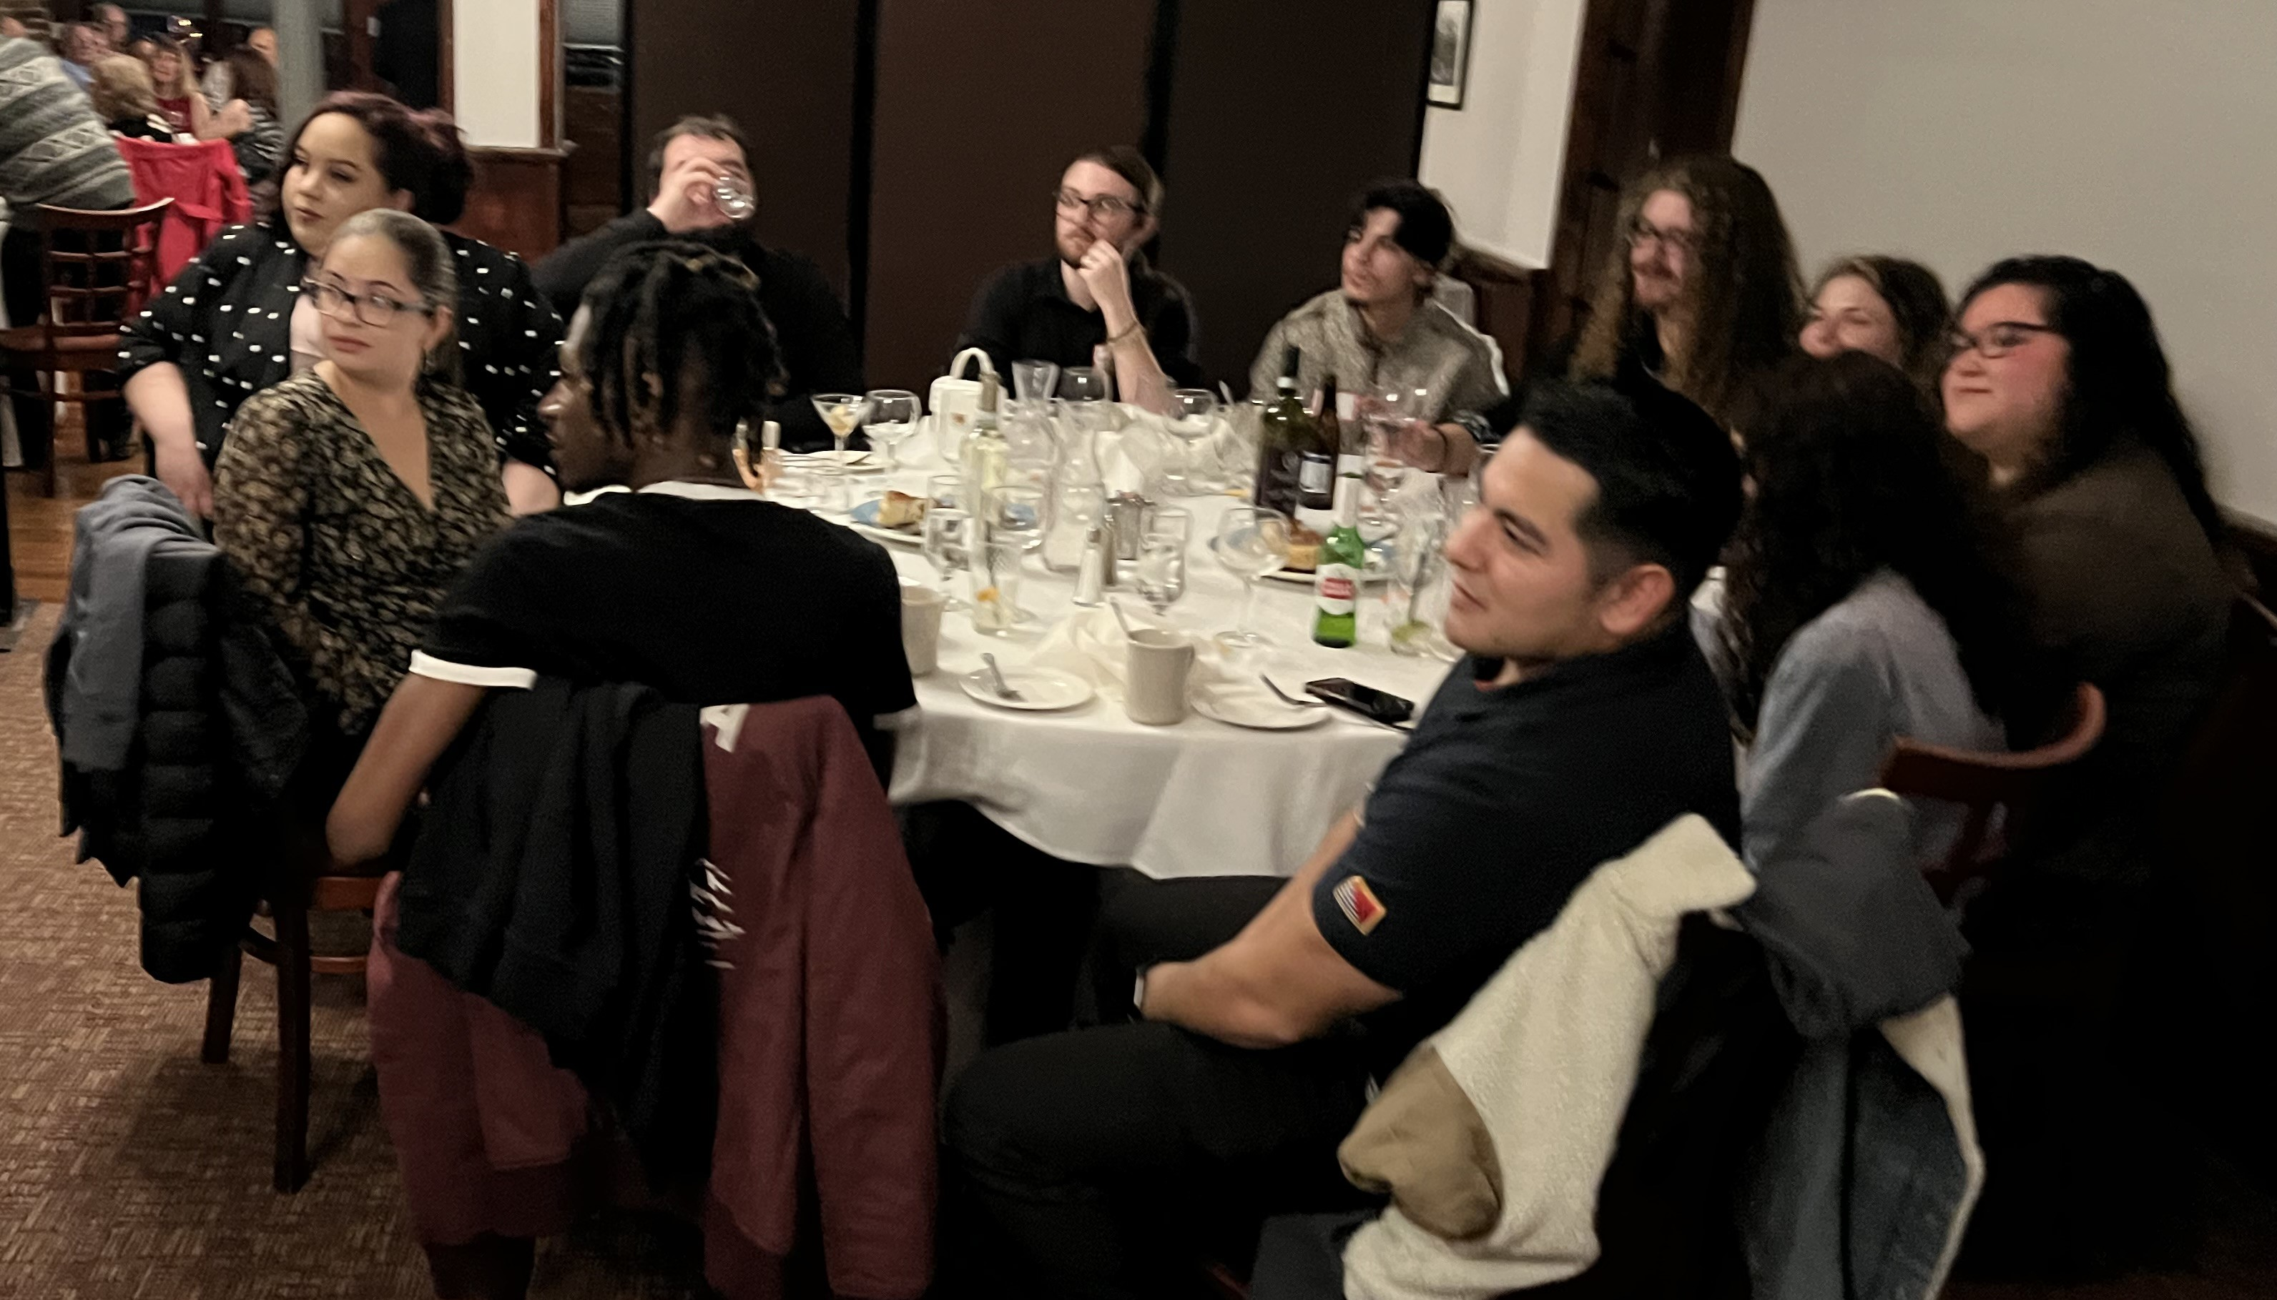
Alumni Dinner 11/10/23

Slide 5
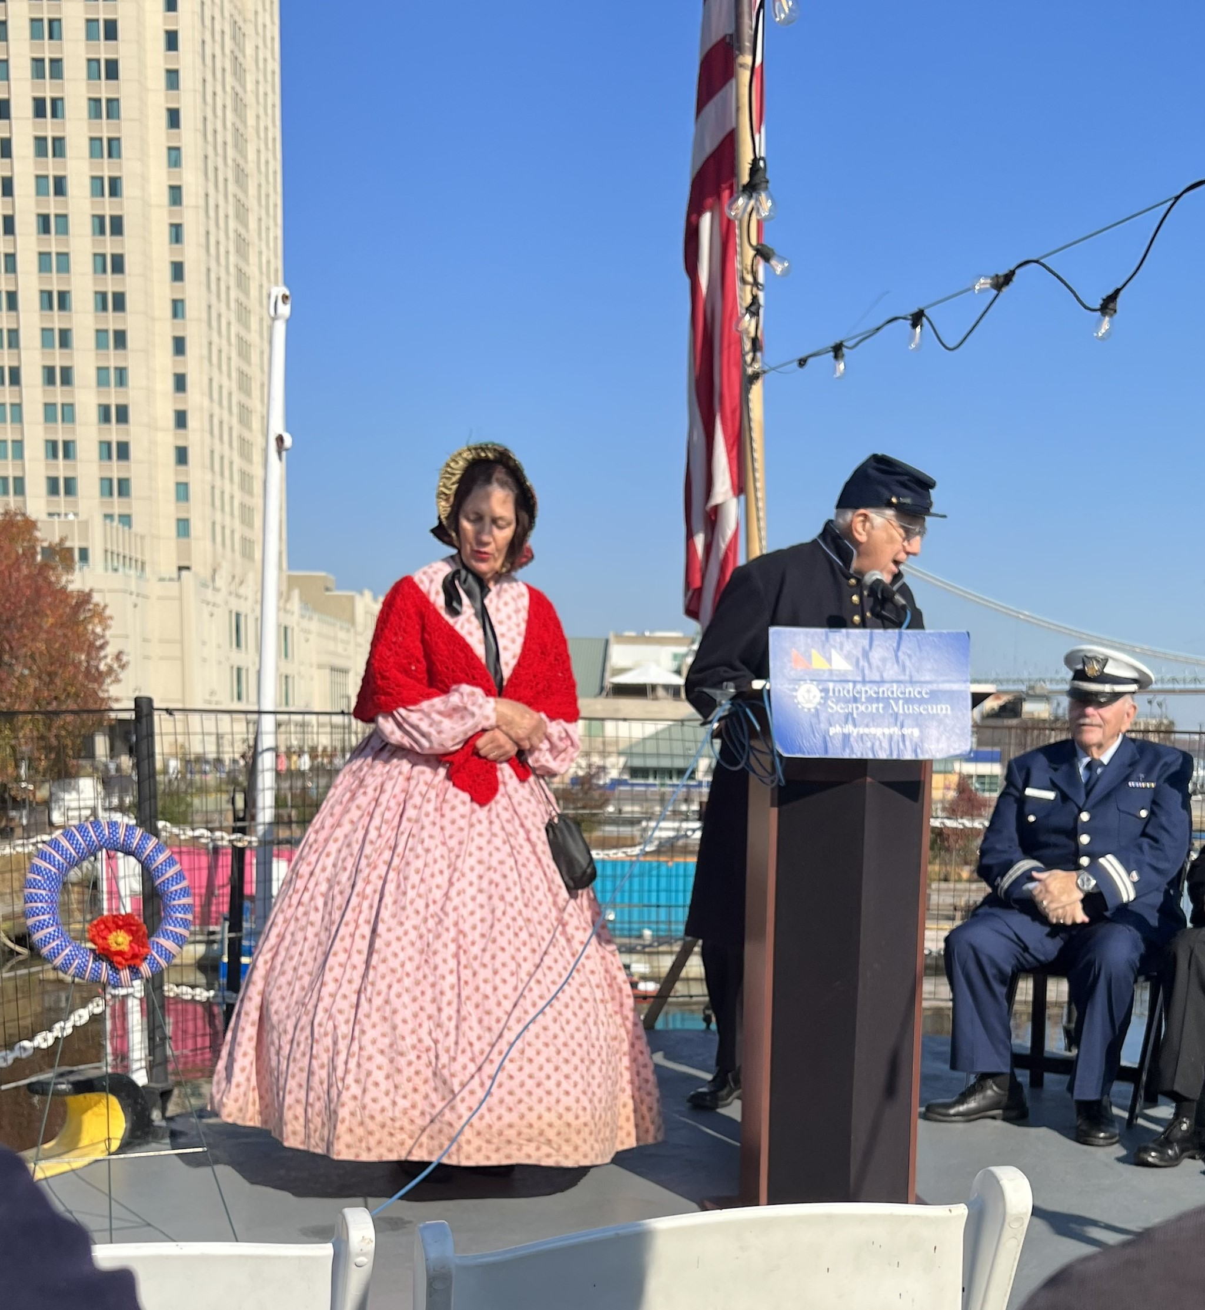
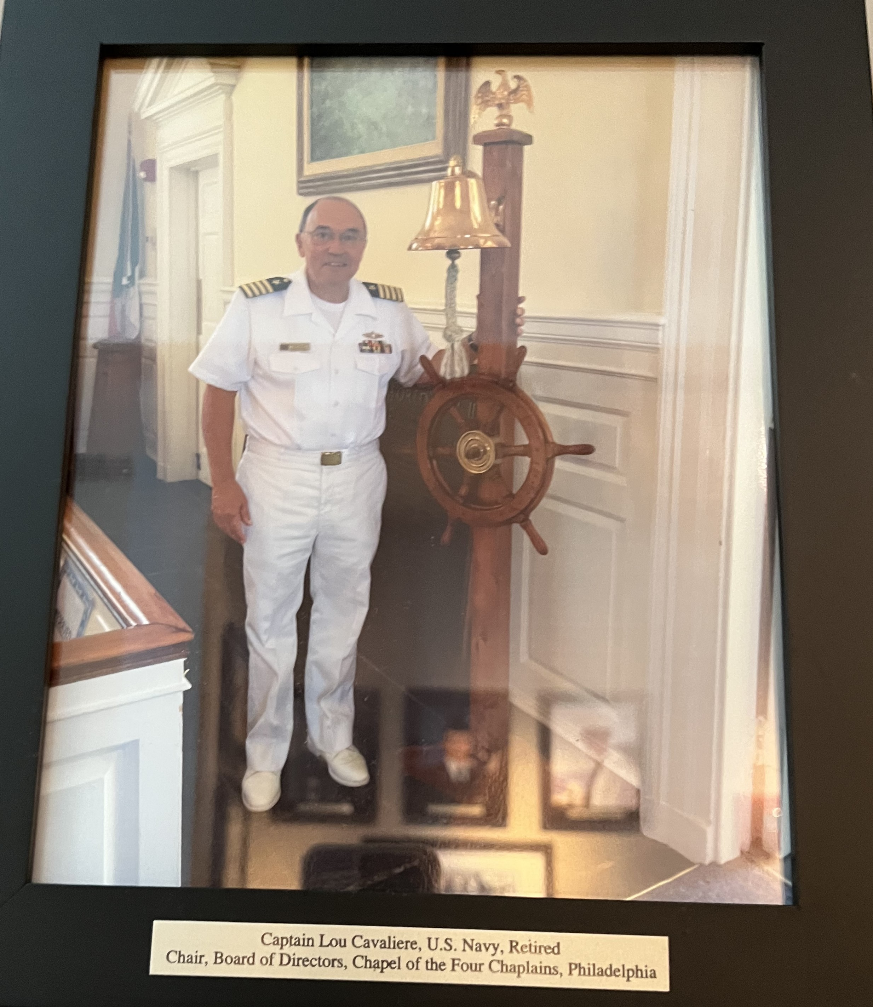
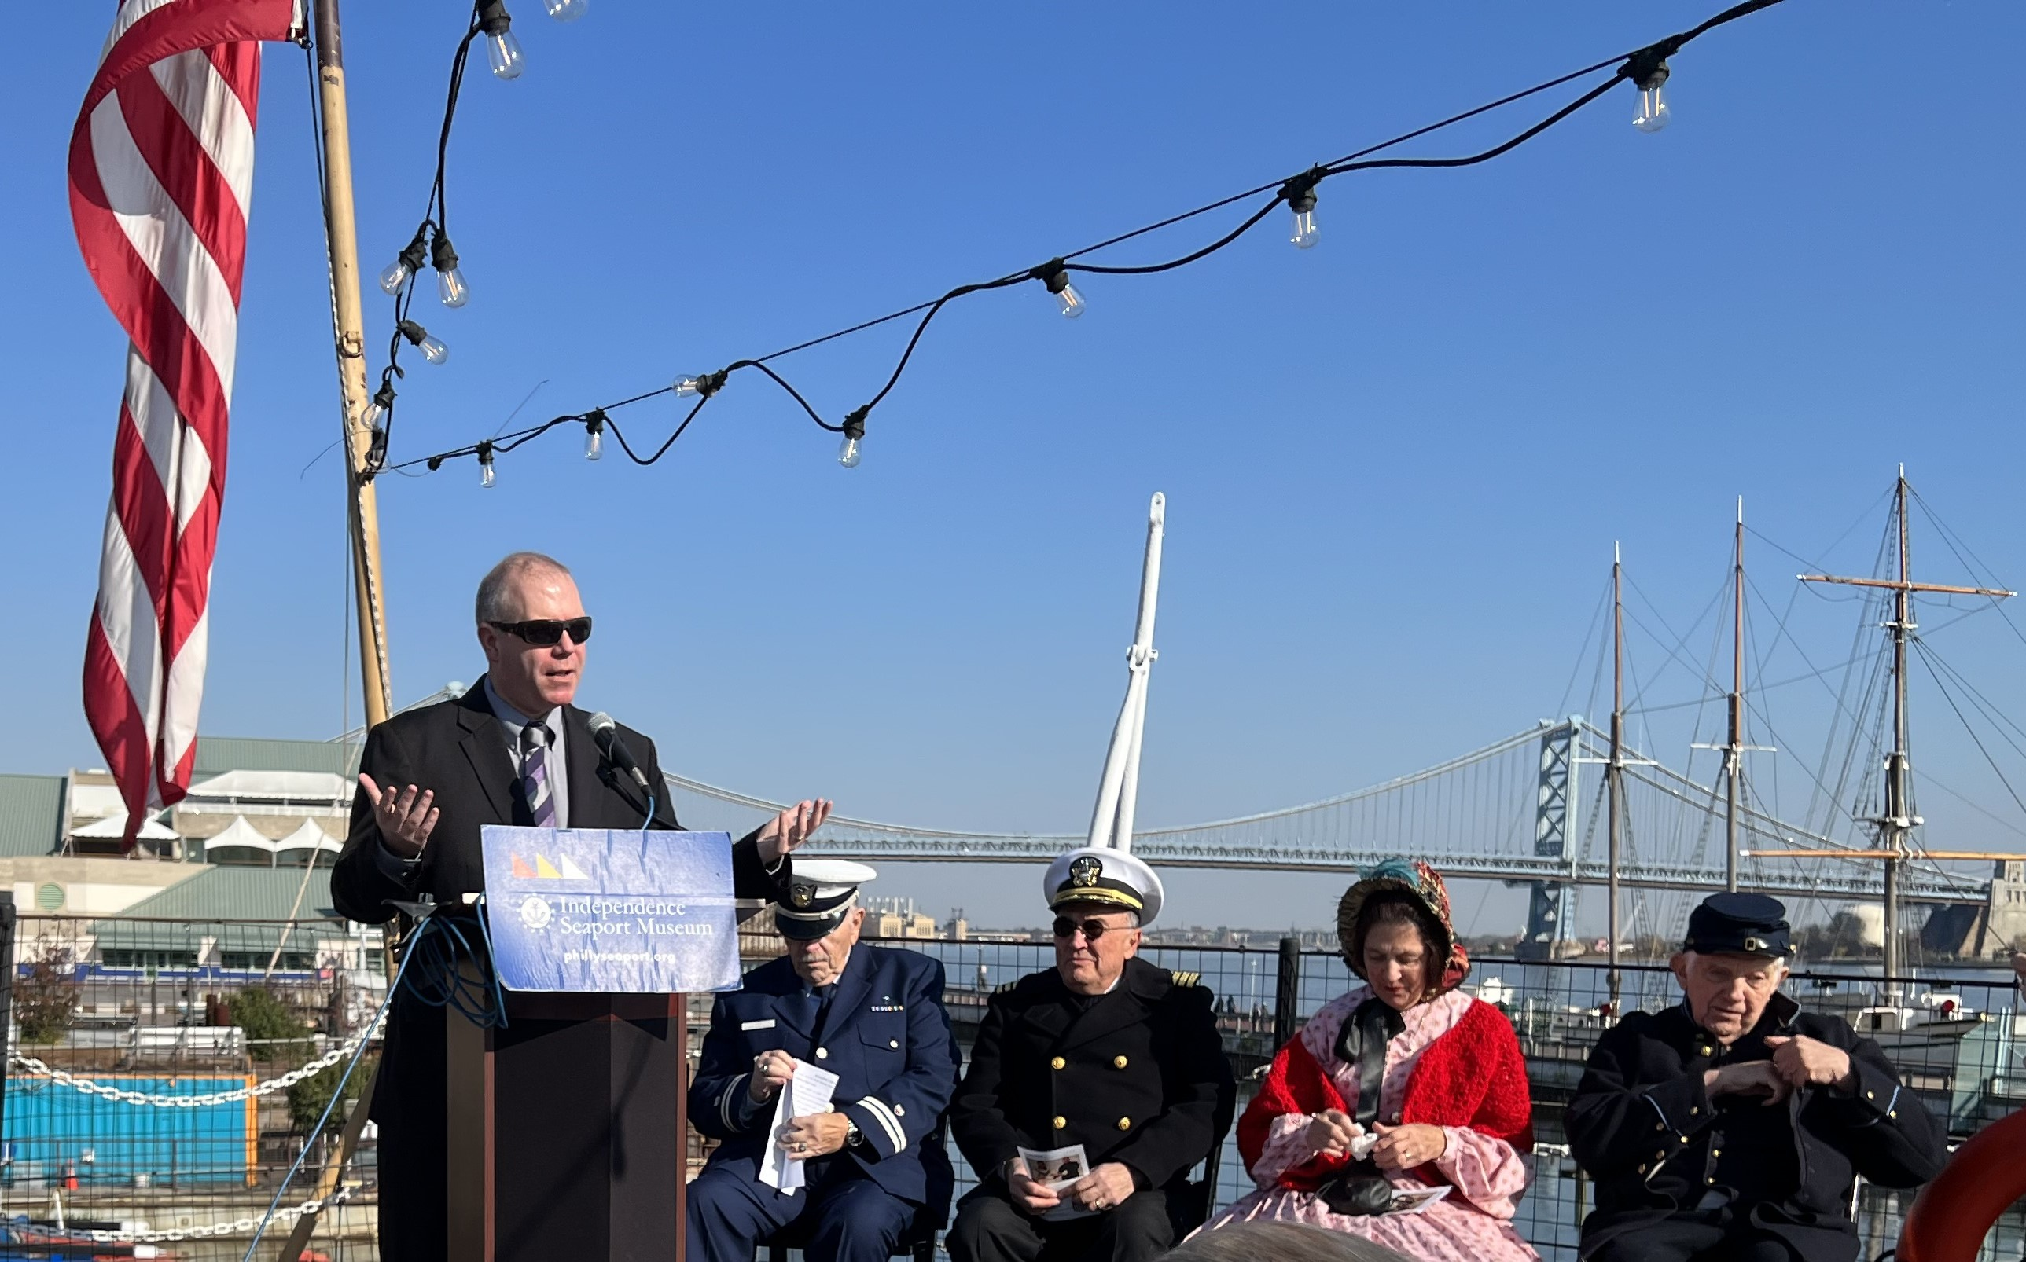
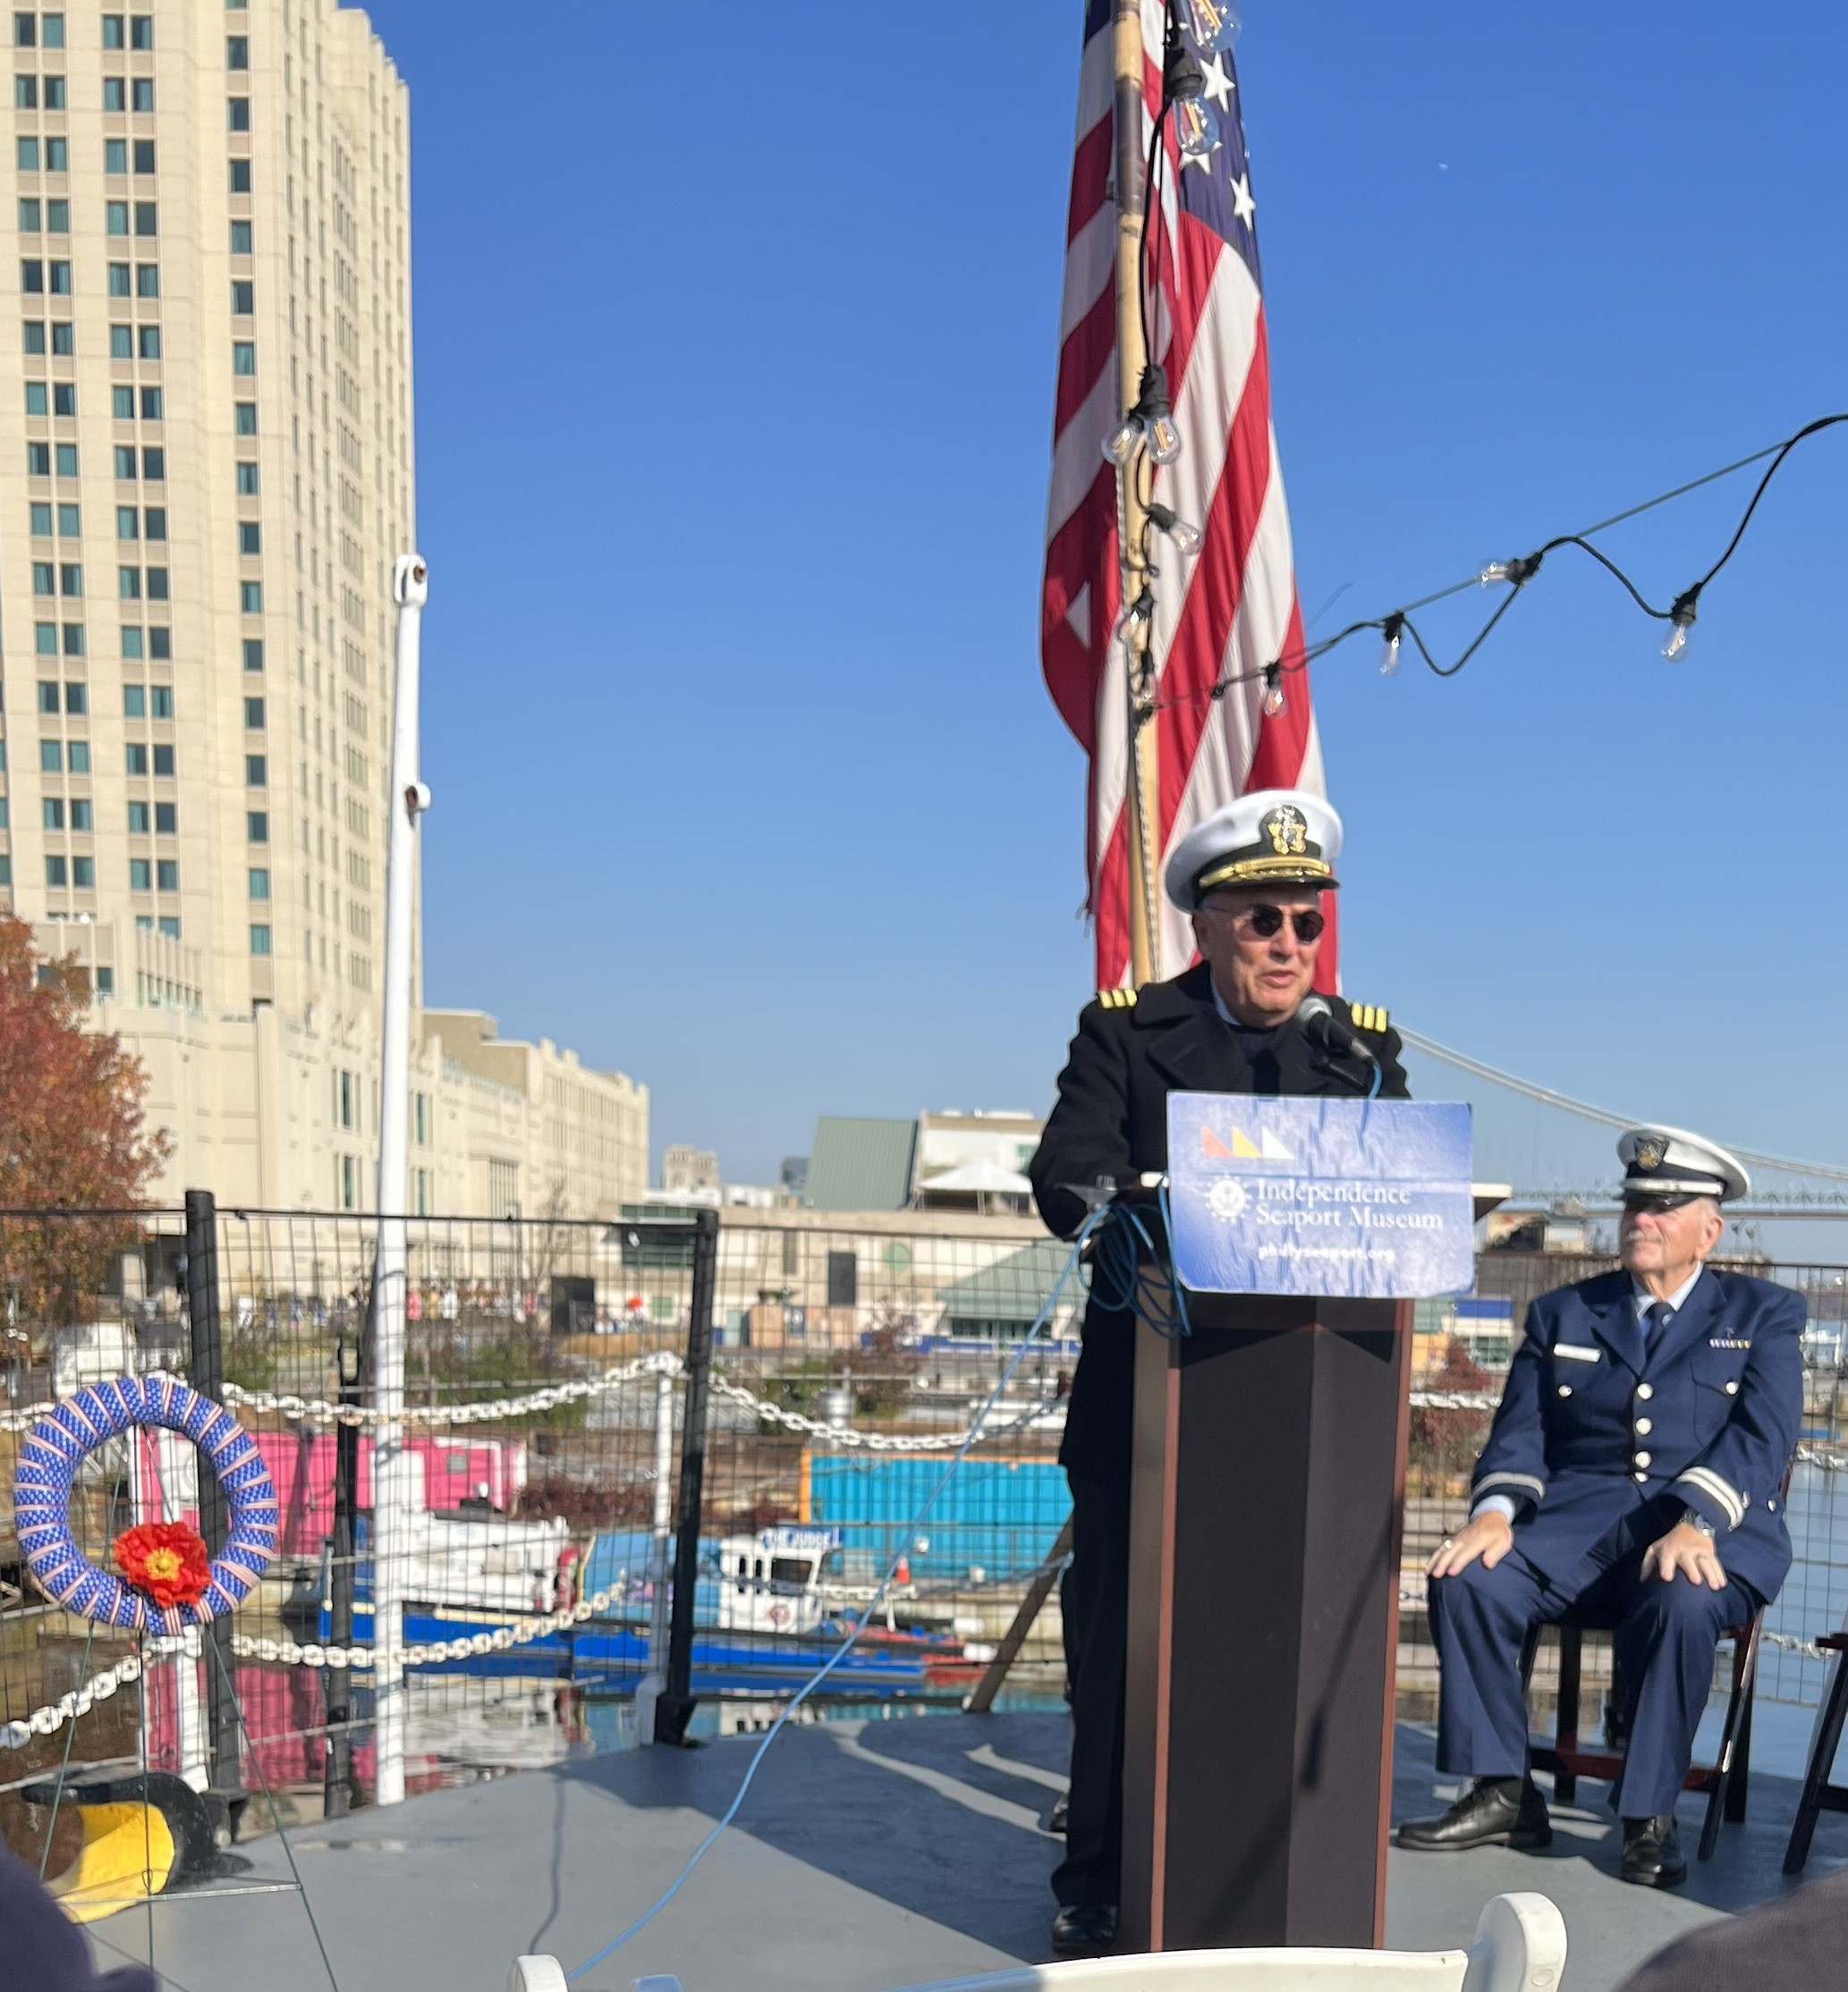
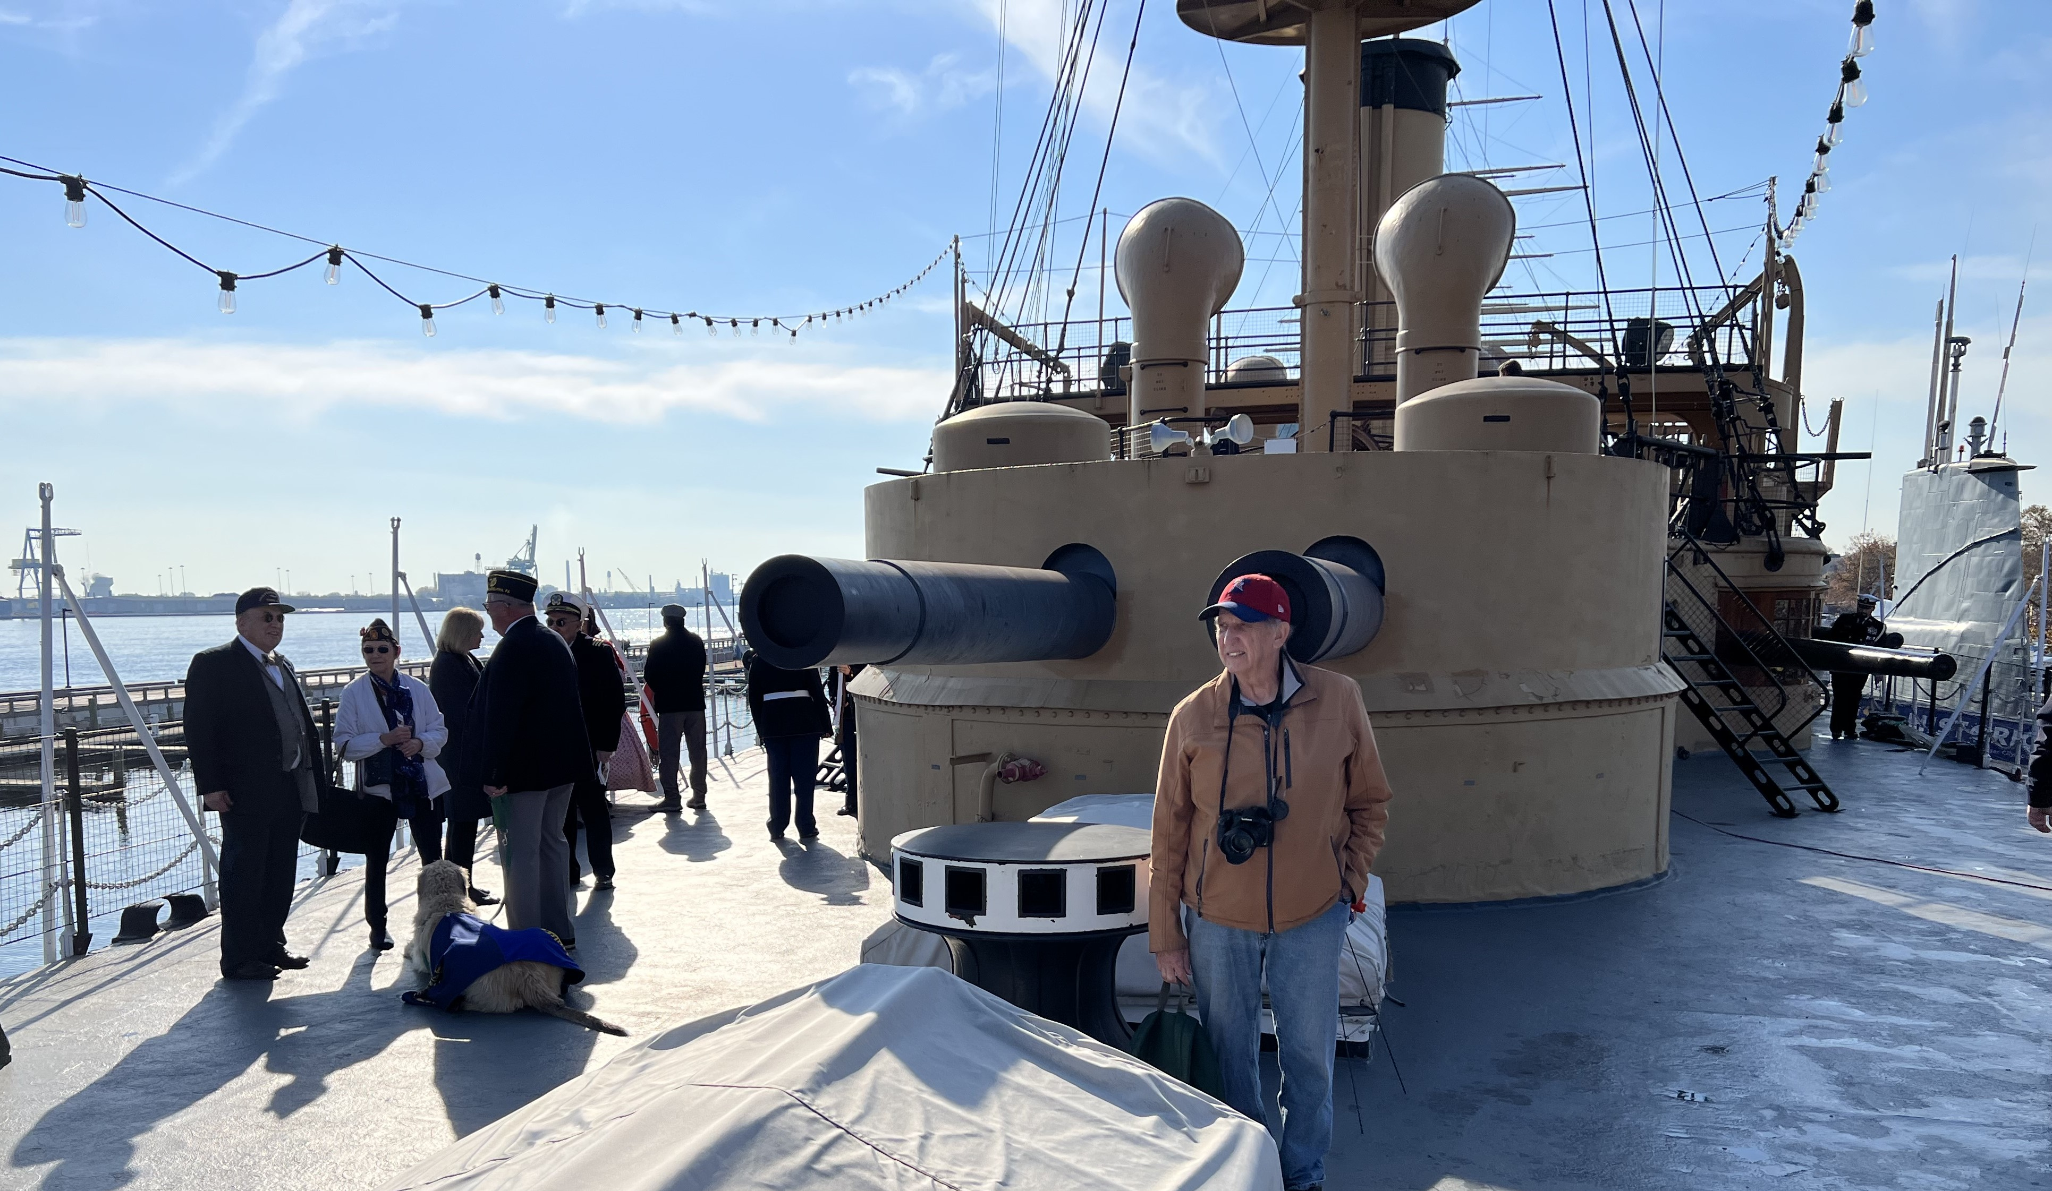
Veterans Day 2023

Slide 6
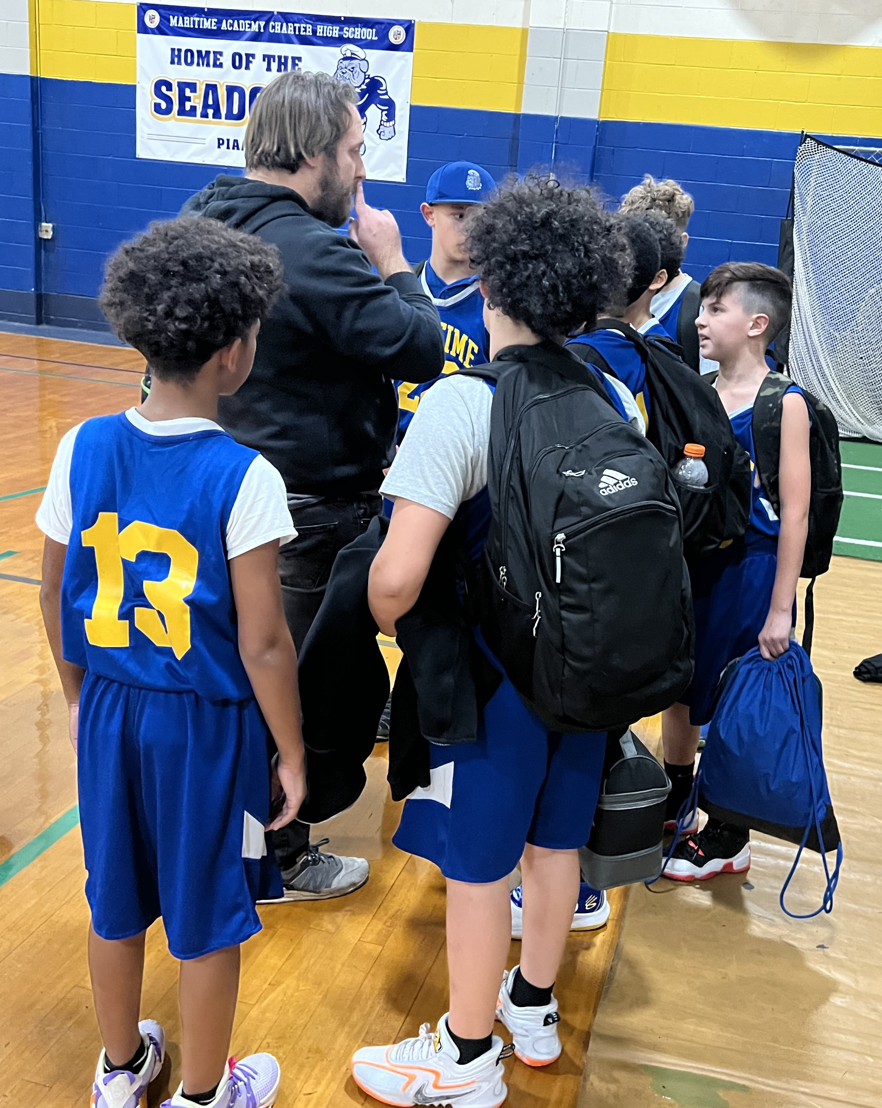
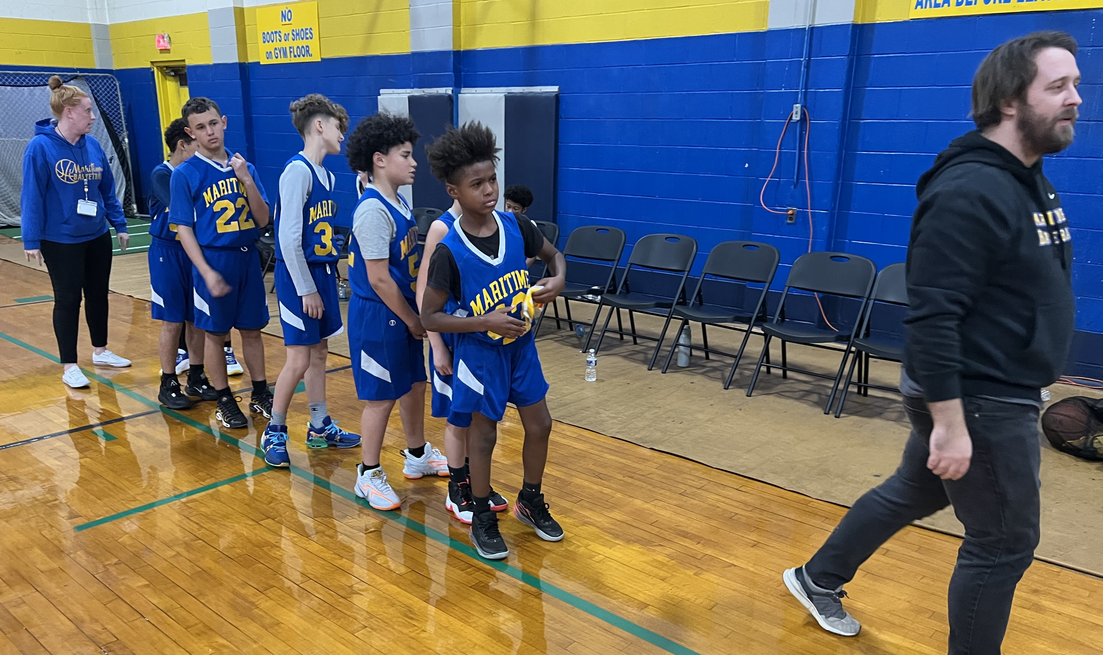
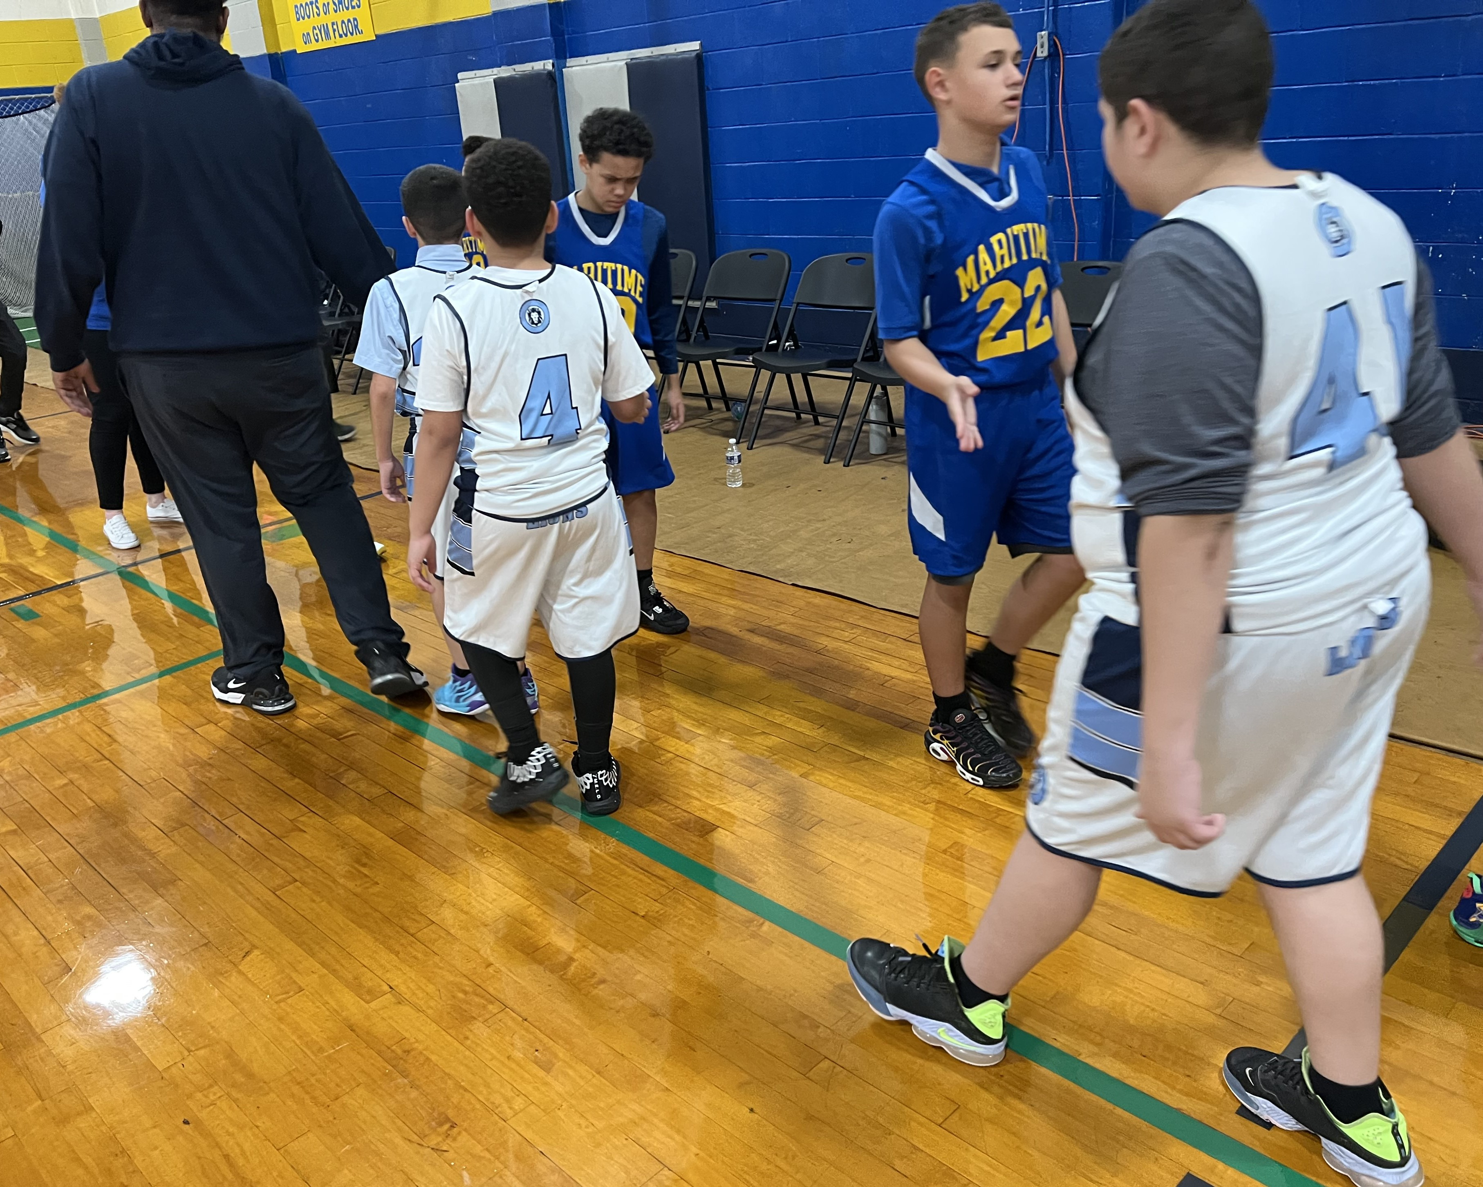
Middle School Boys Basketball 11/14/23

Slide 7
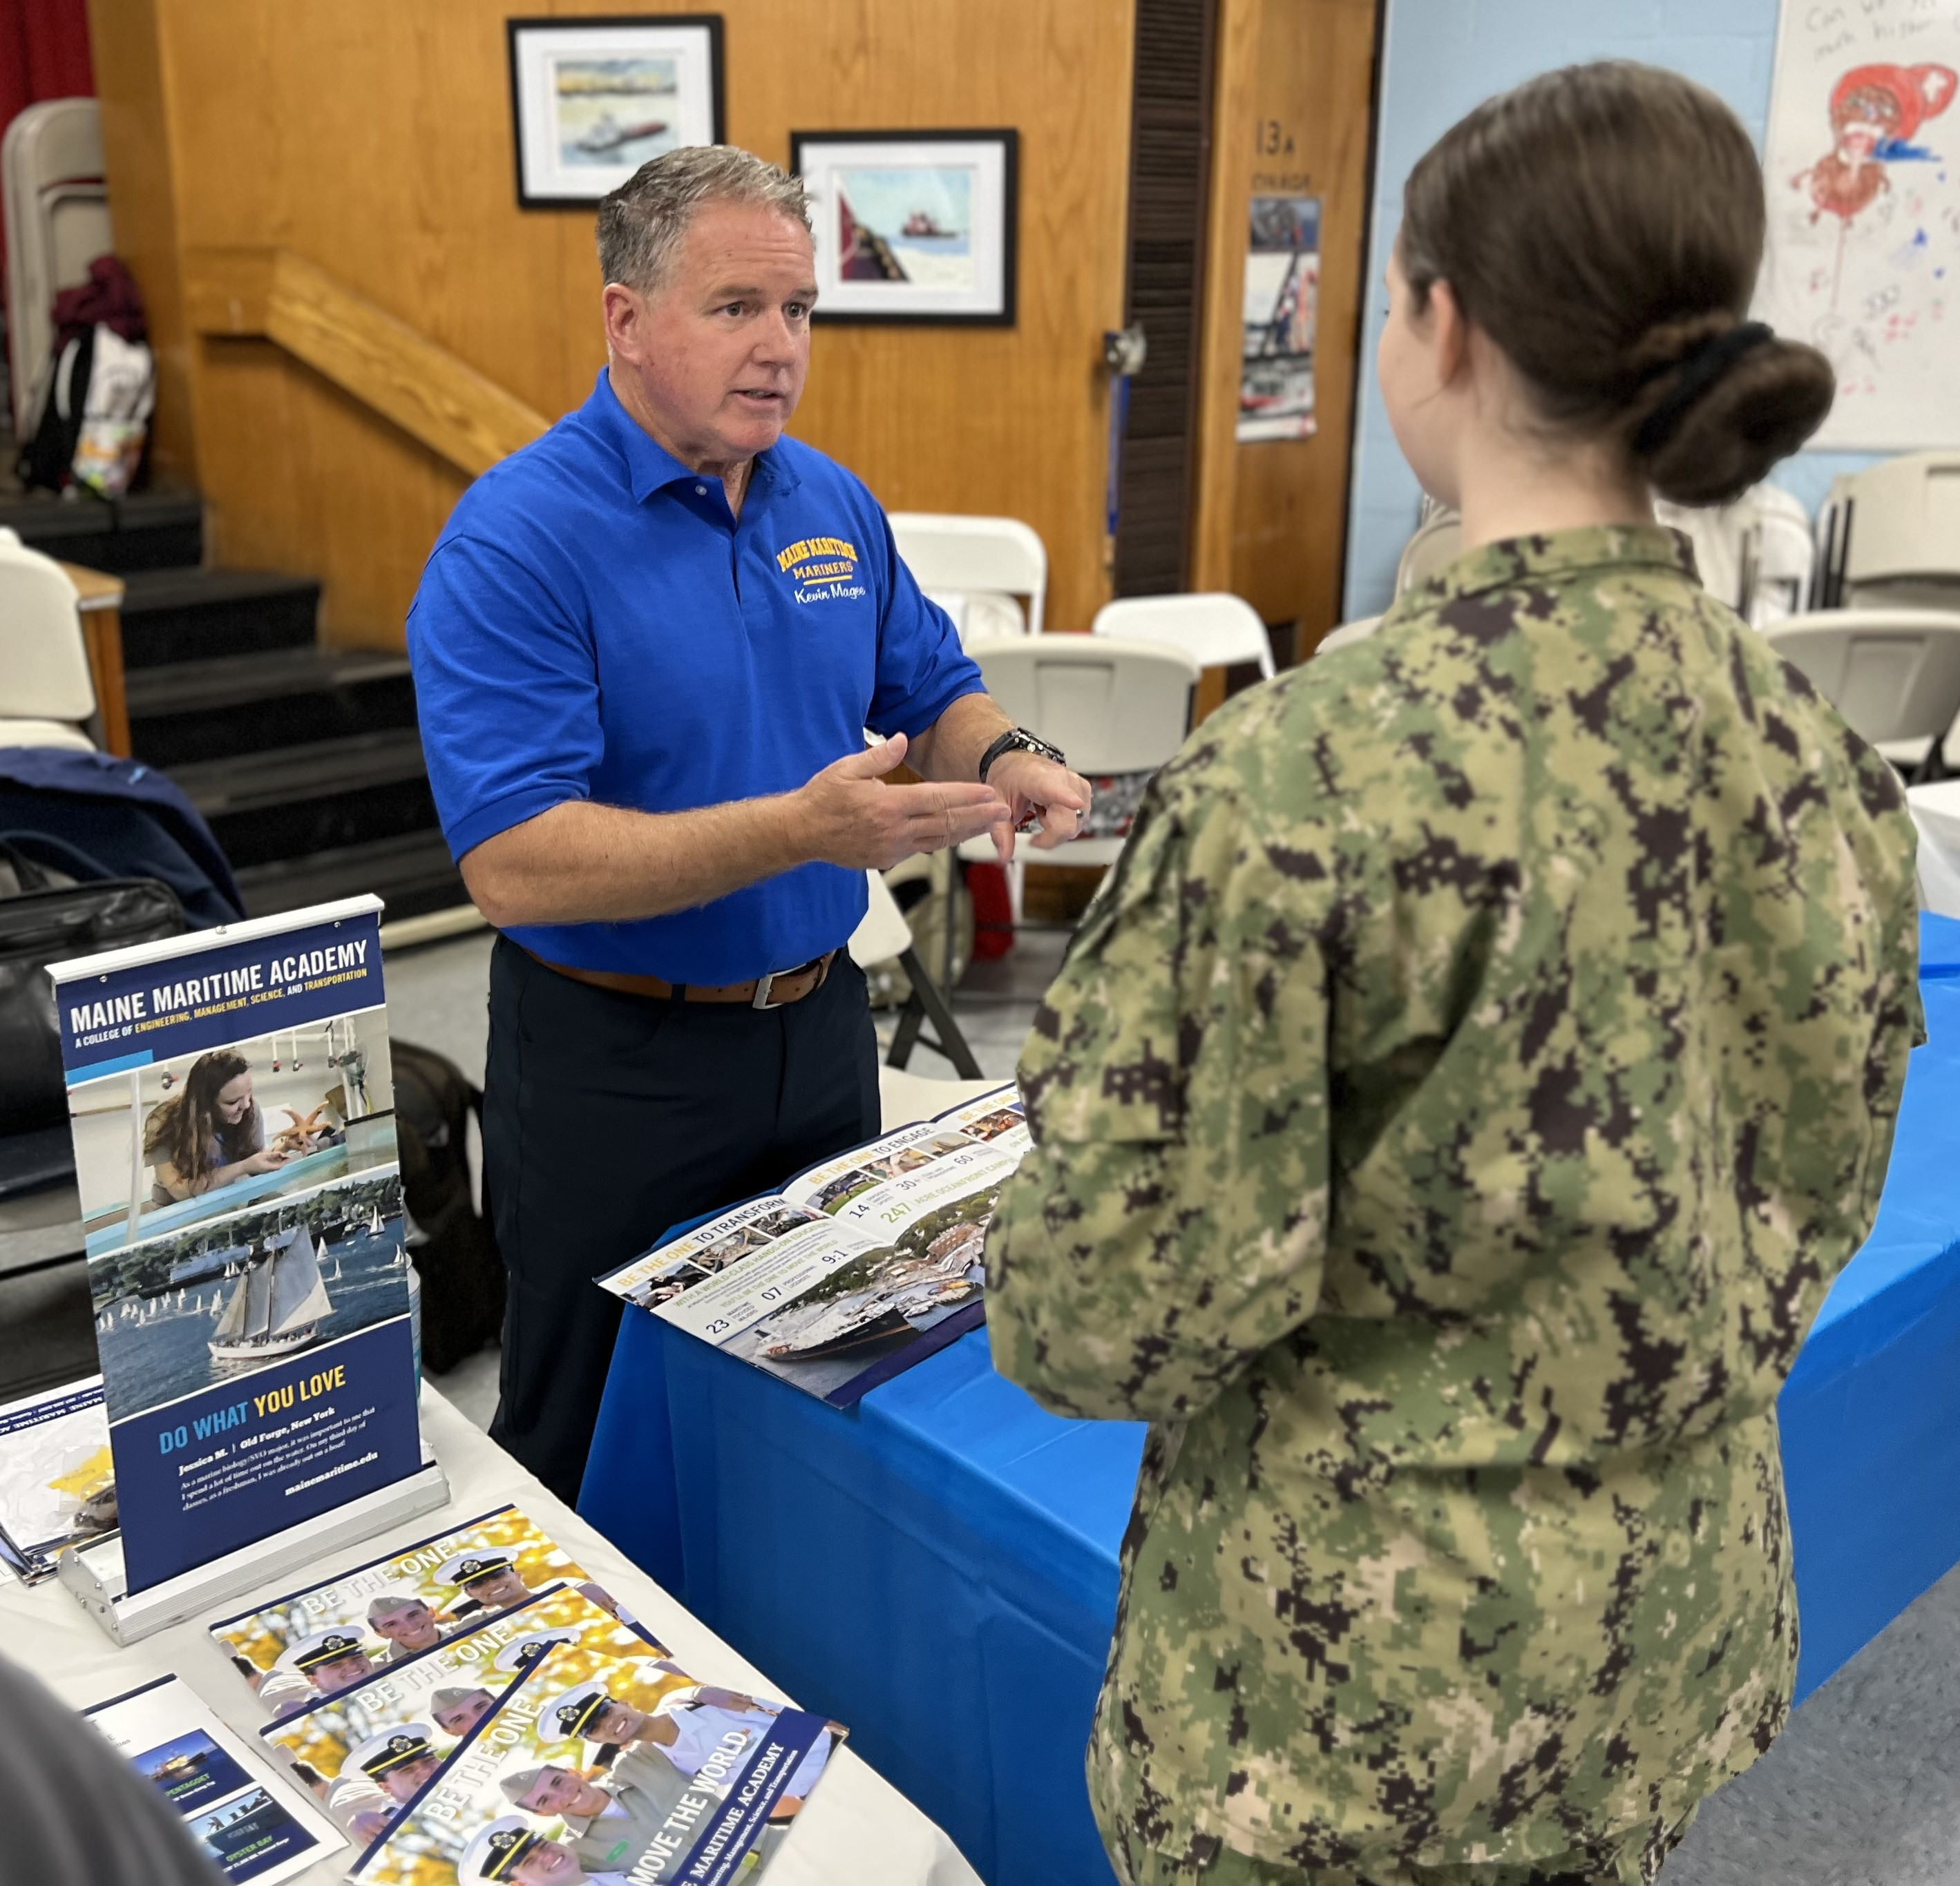
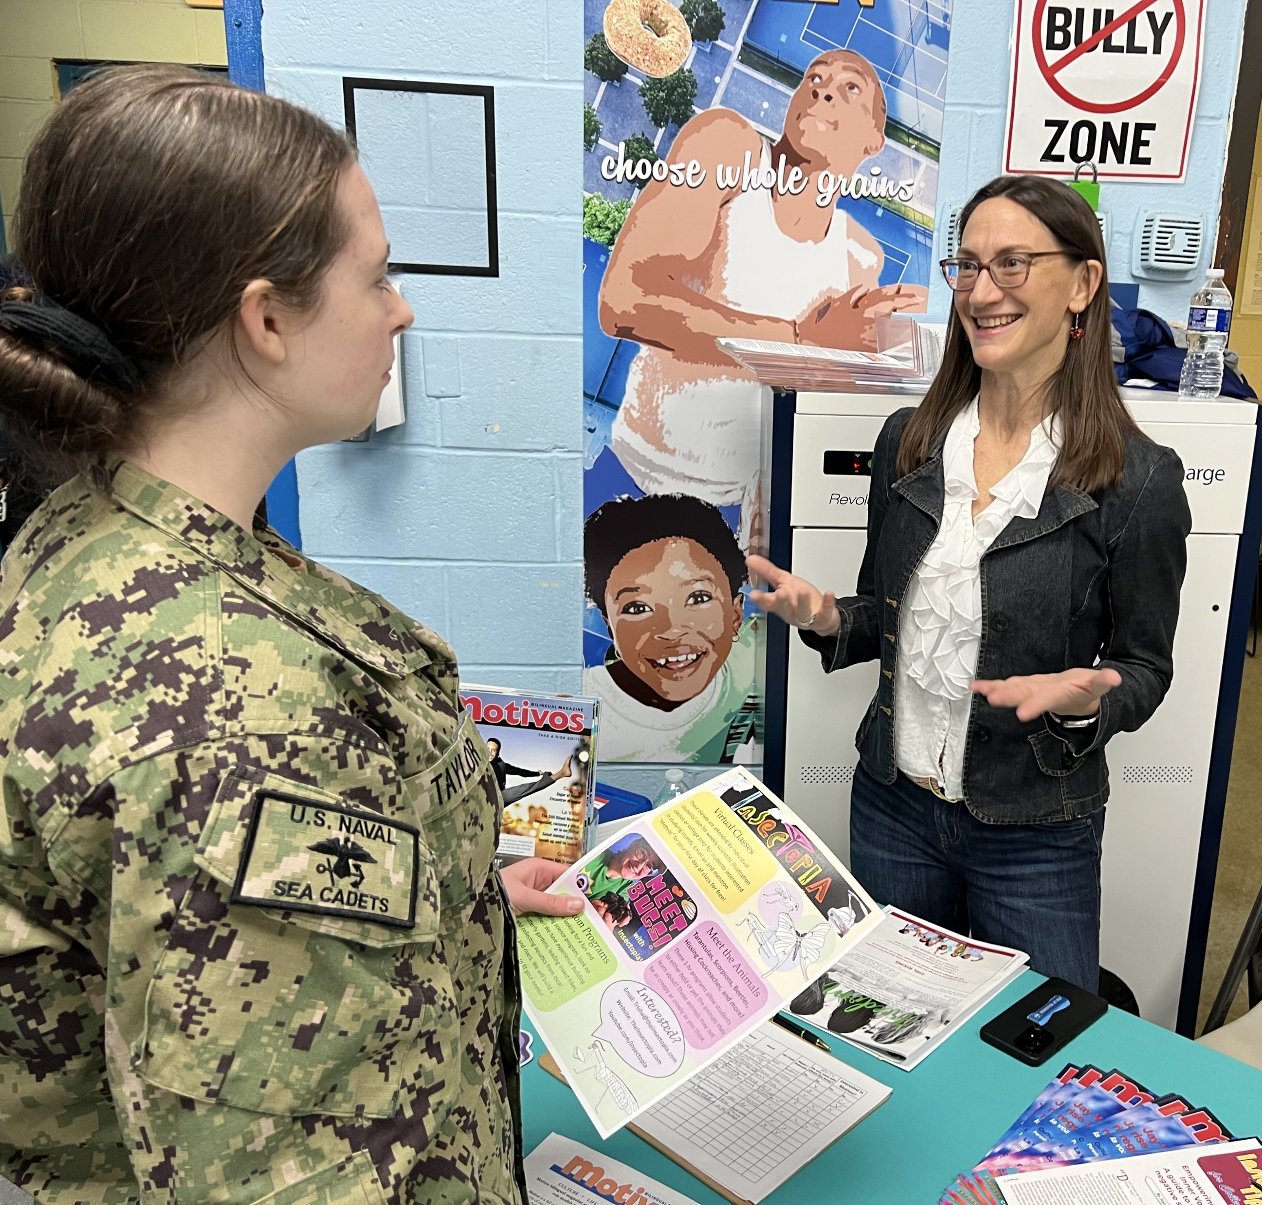
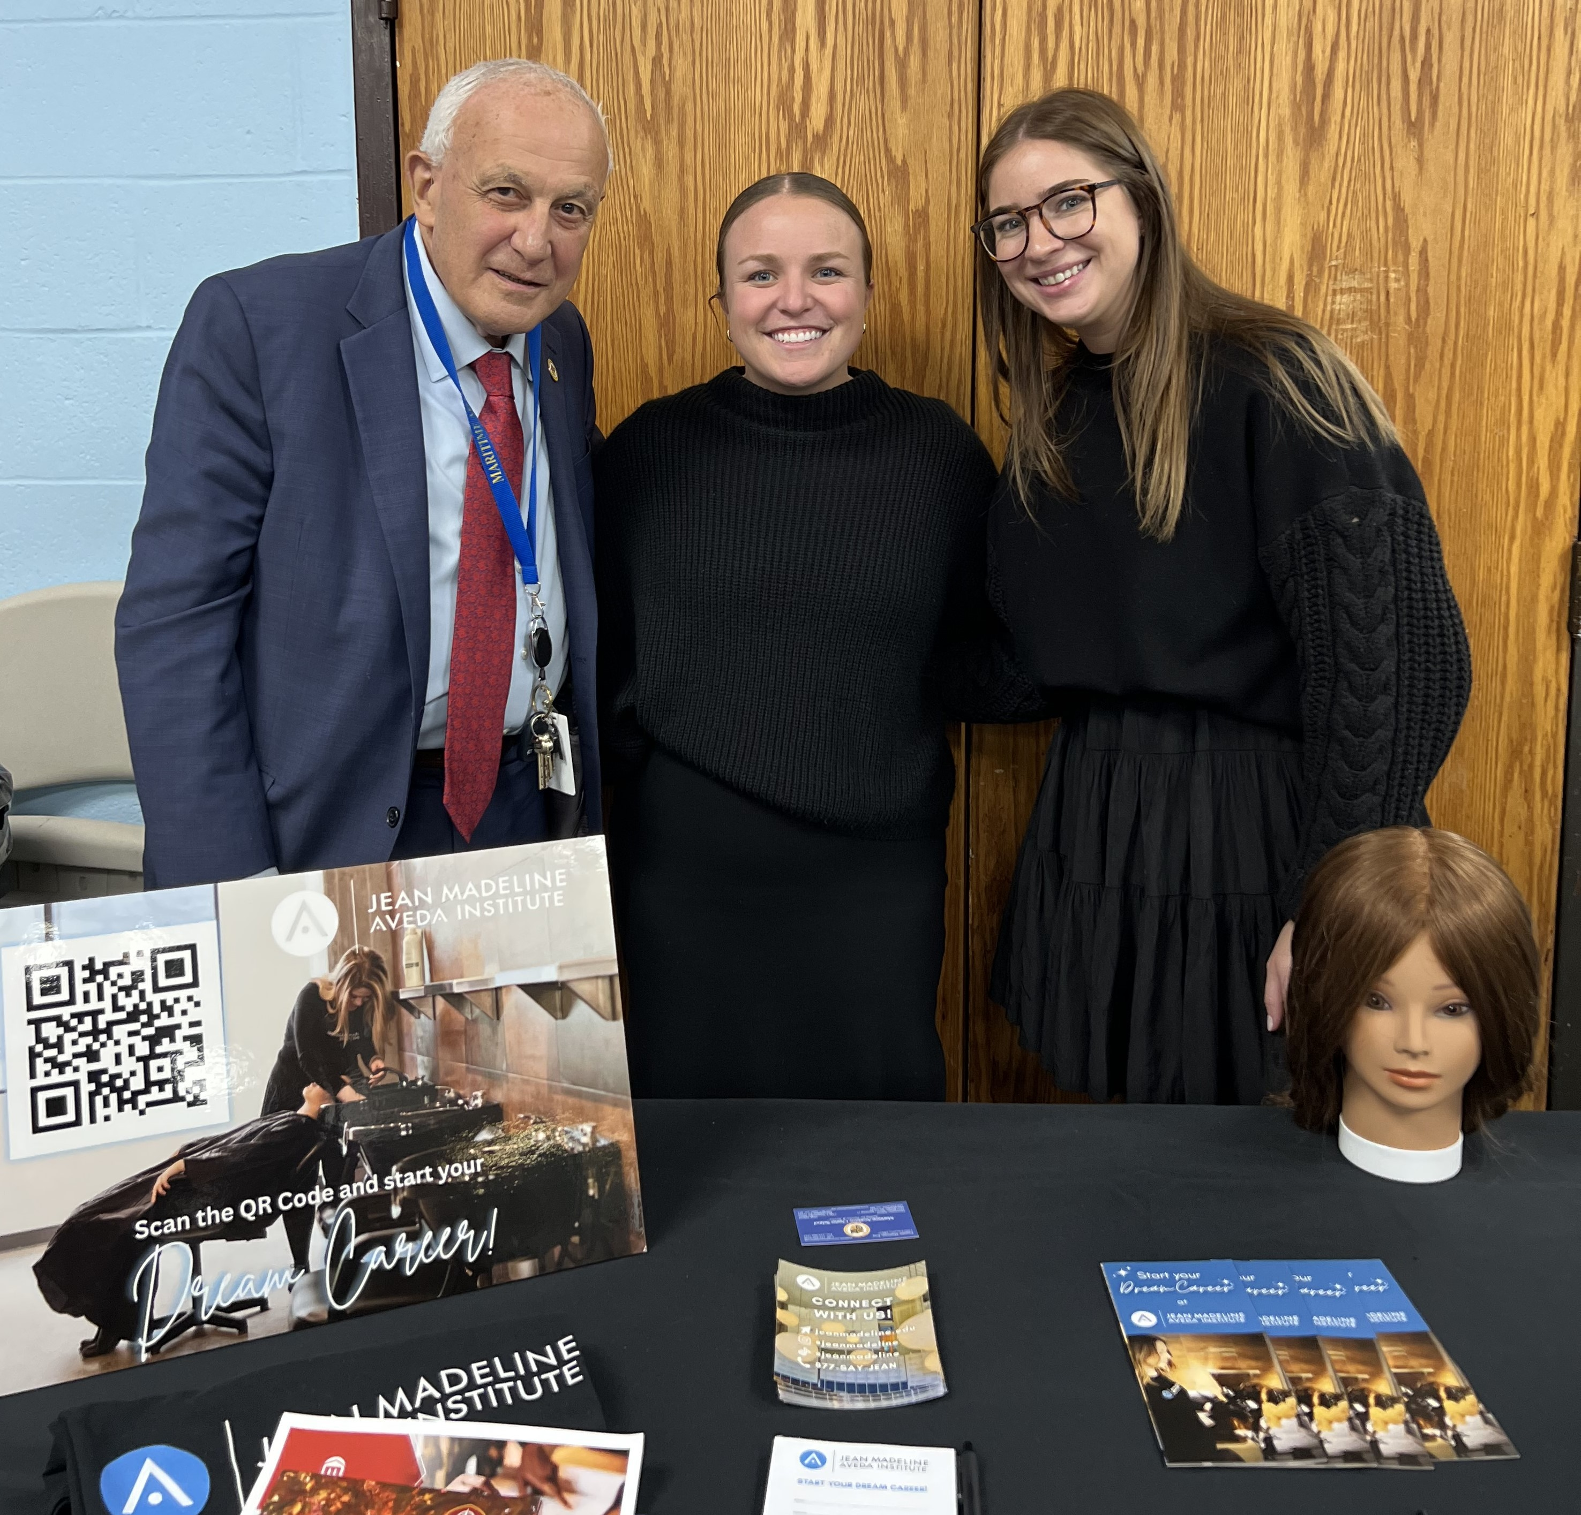
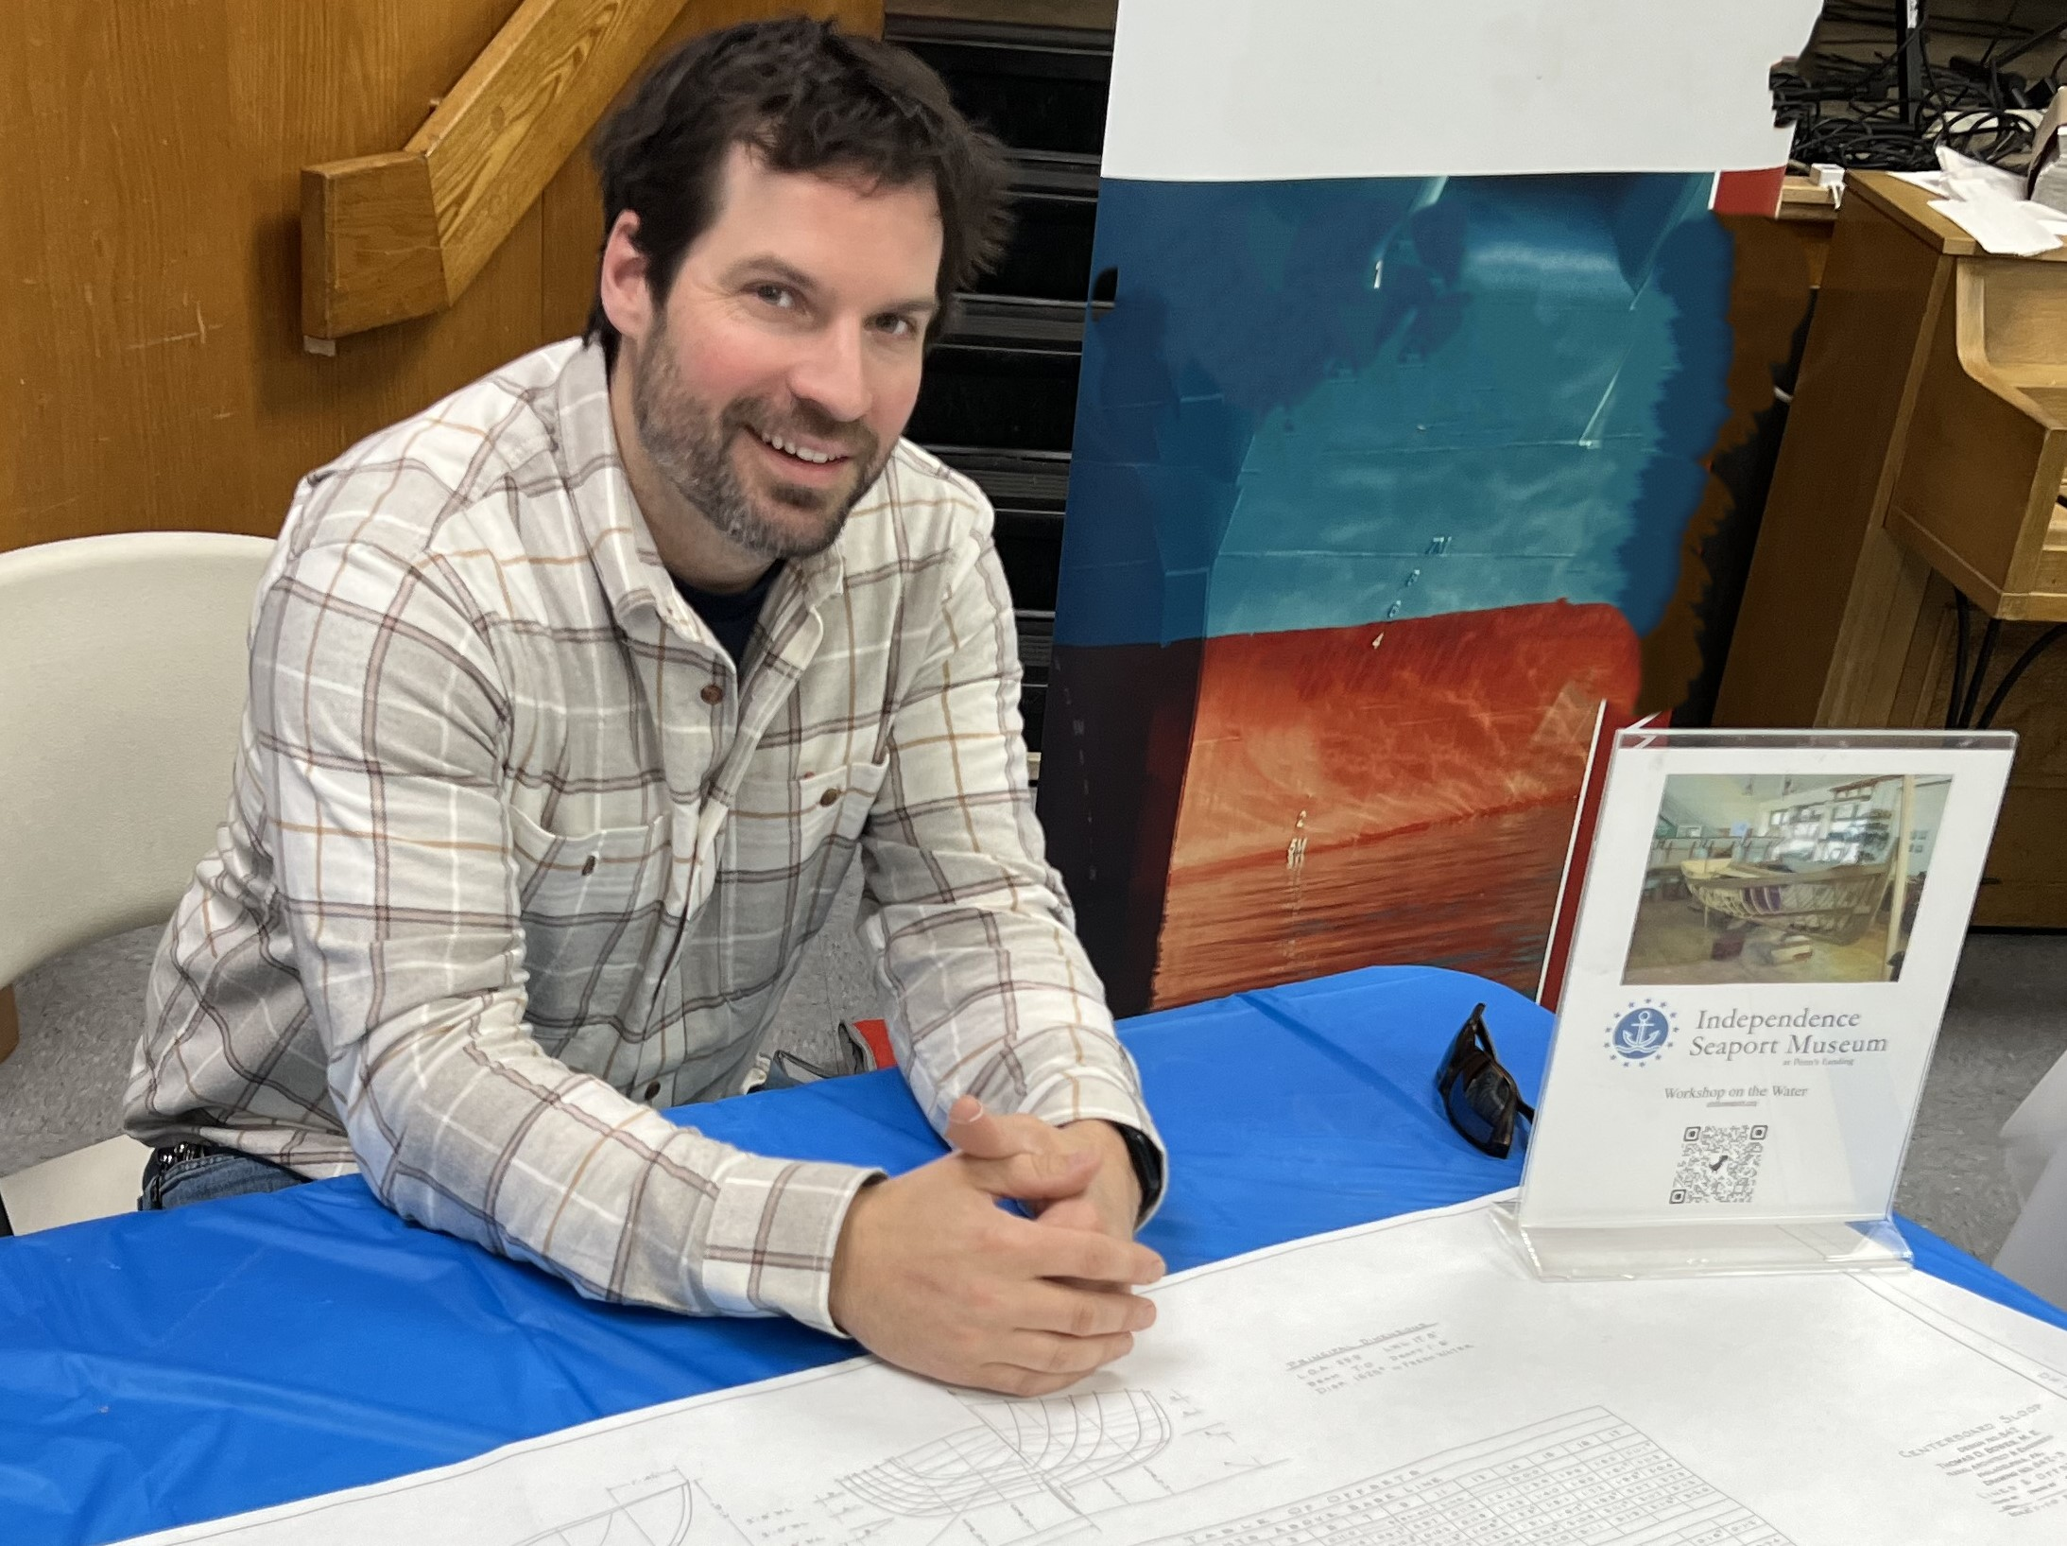
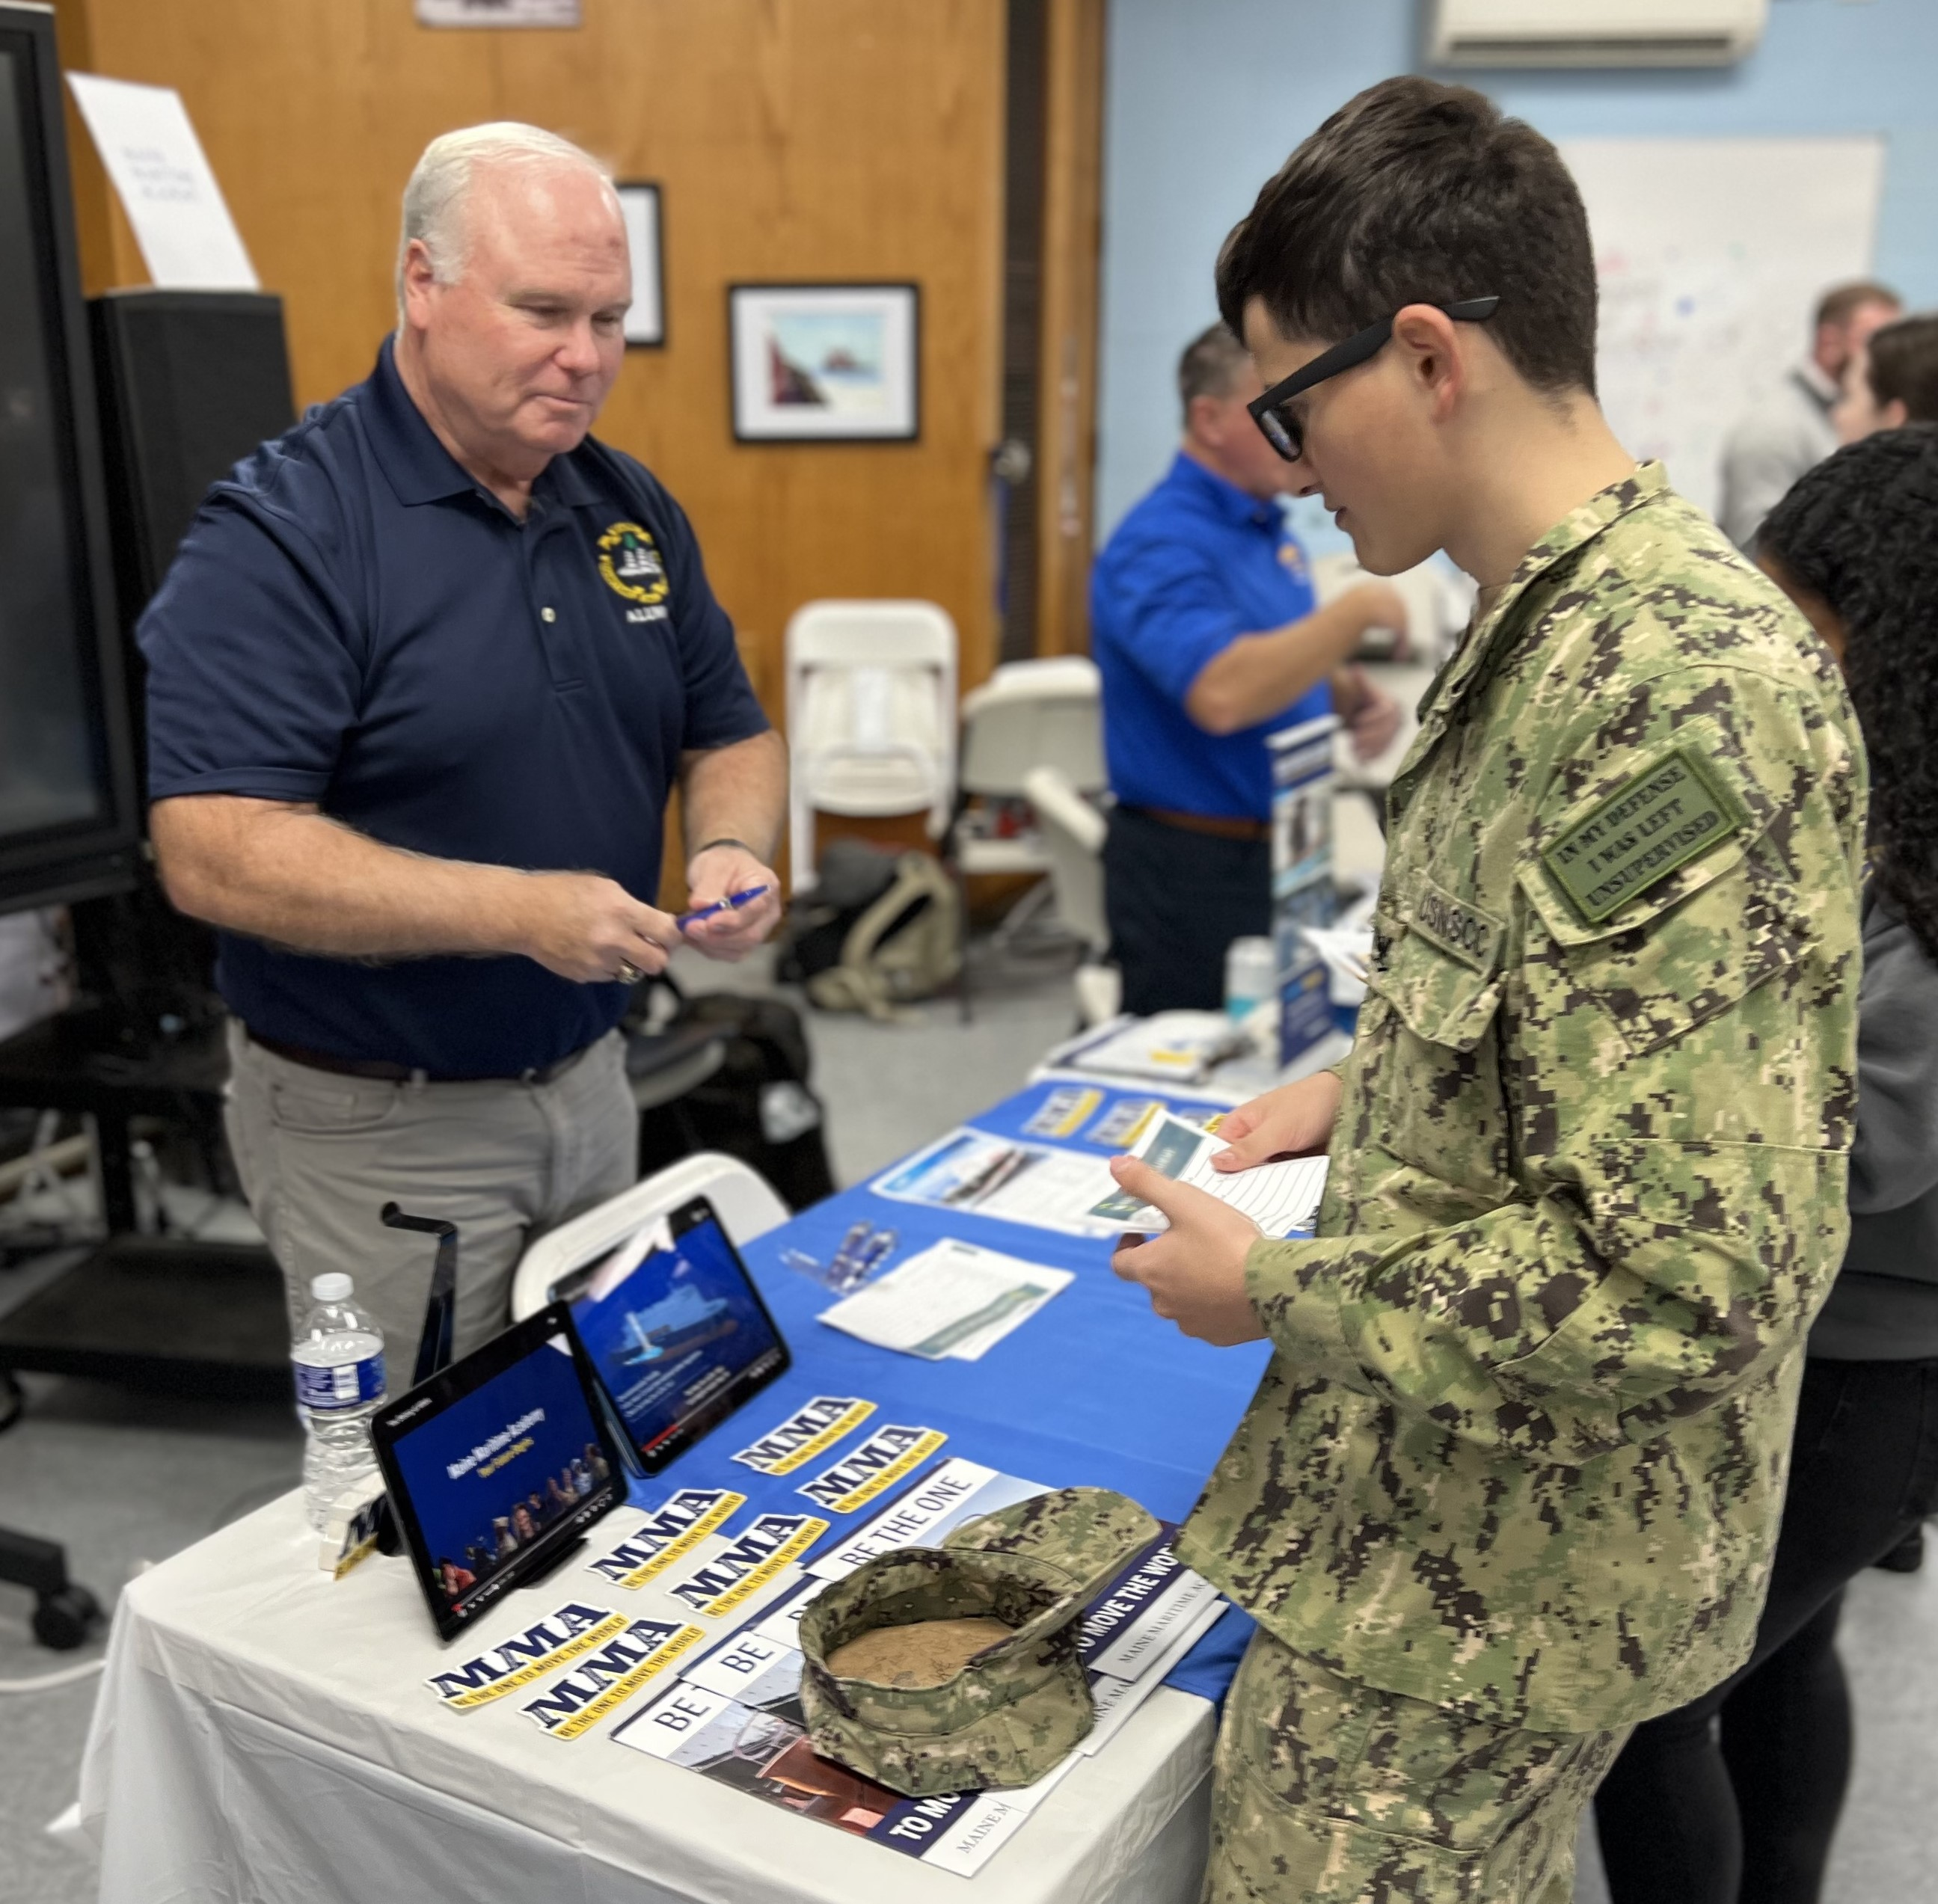
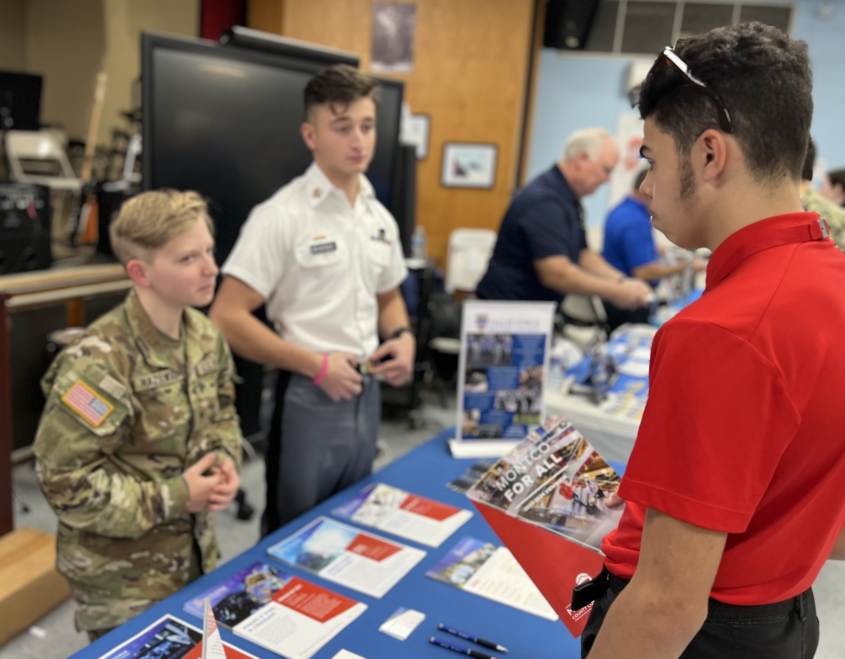
High School Career Day 11/16/23

Slide 8
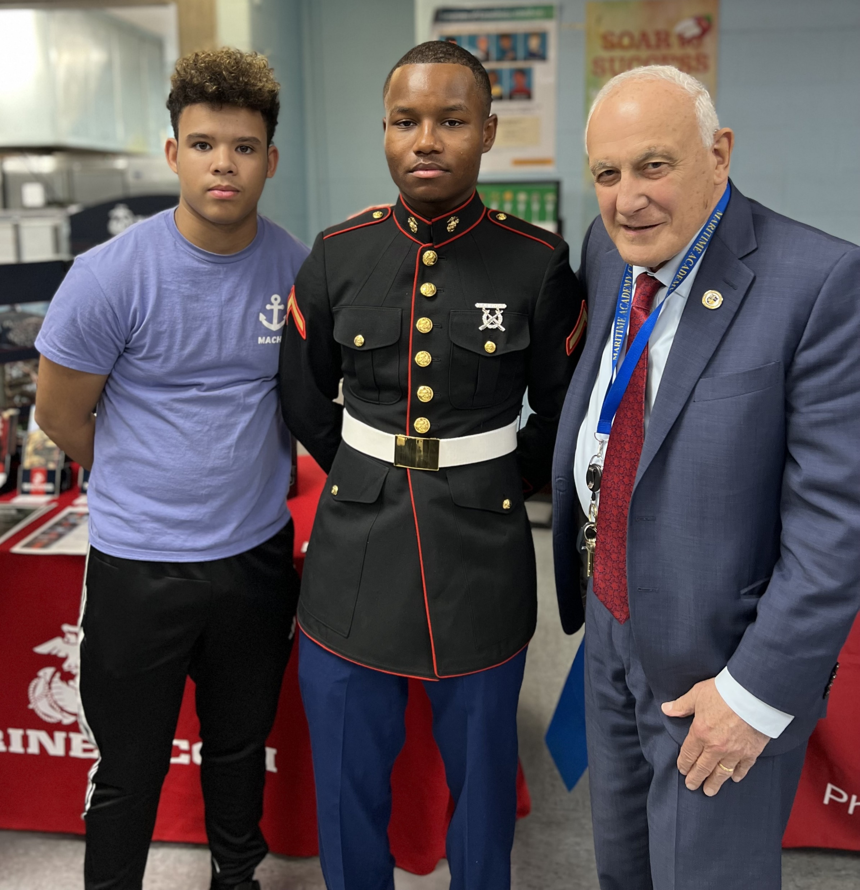
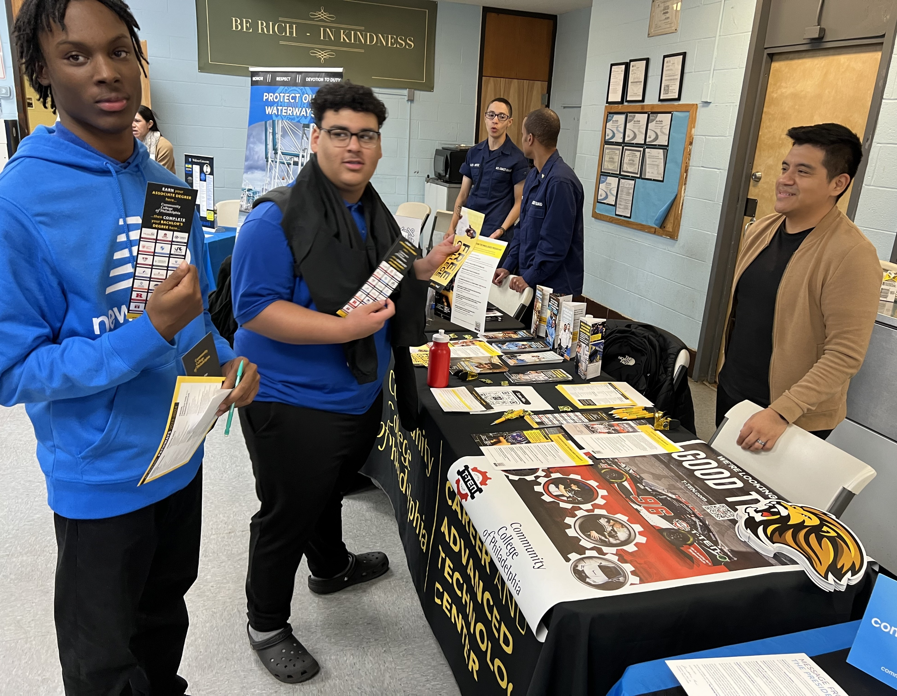
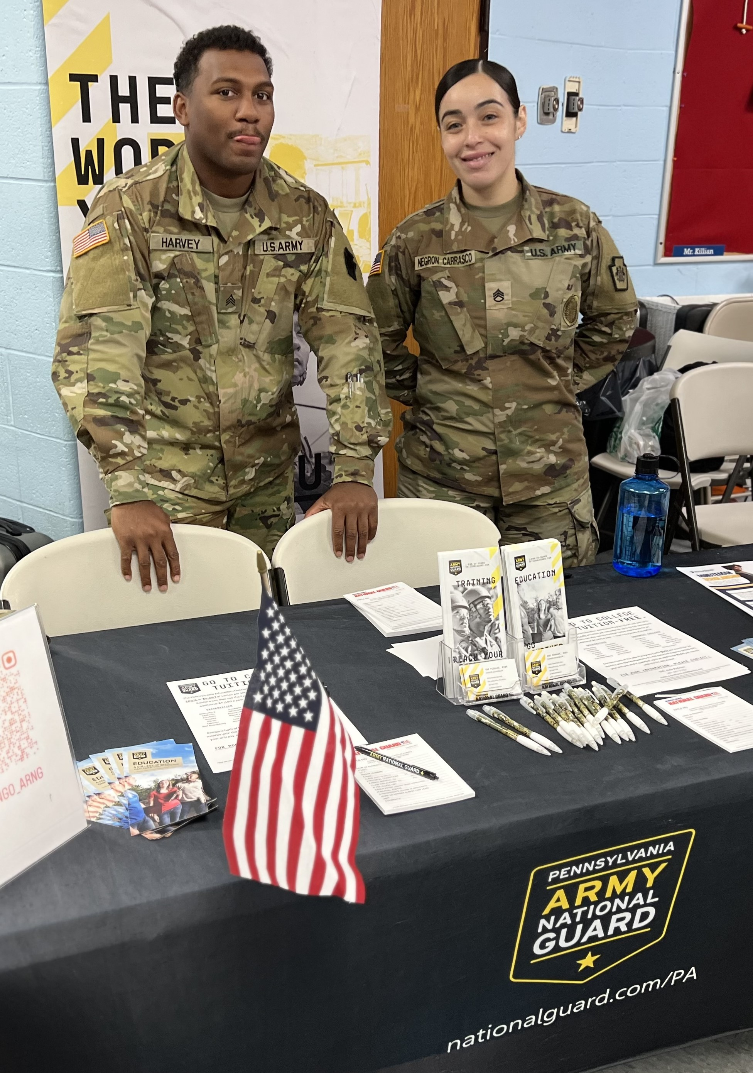
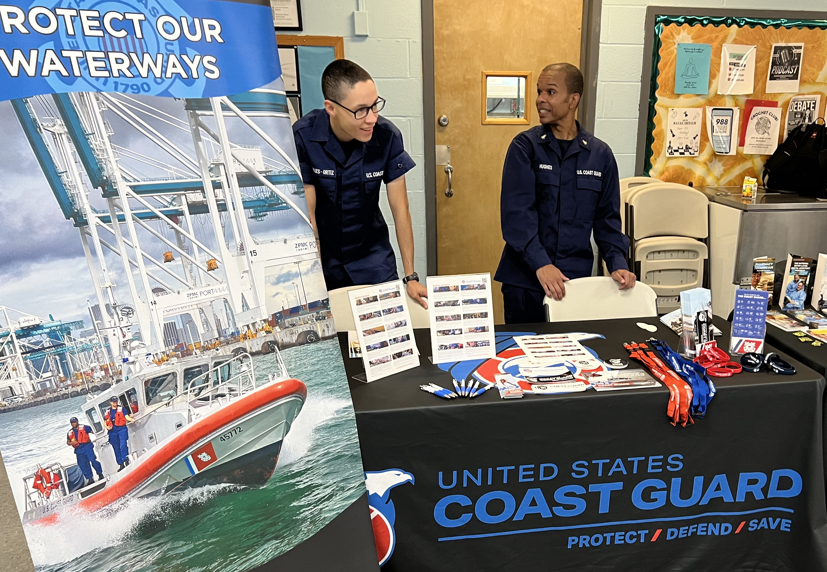
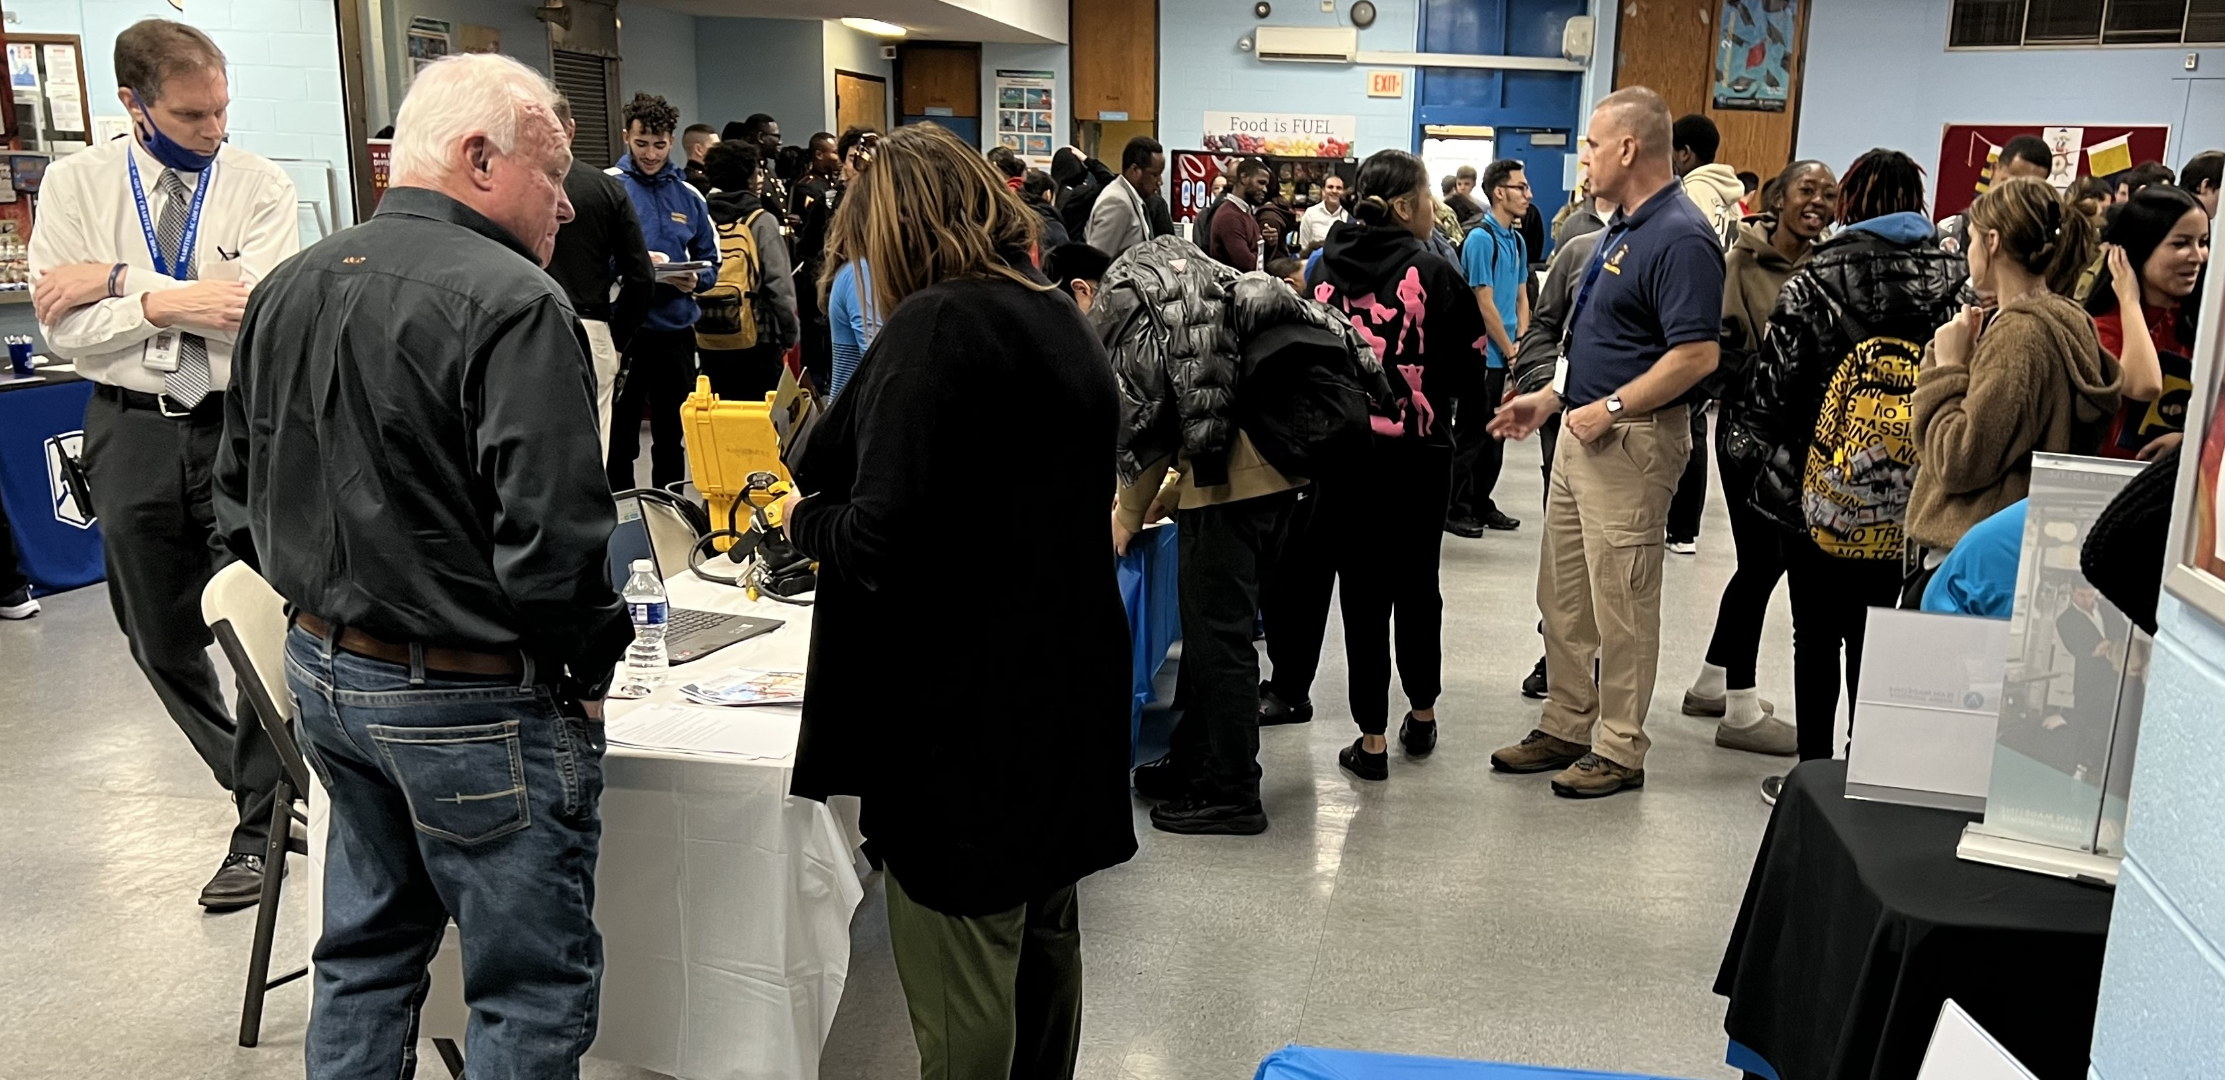
High School Career Day 11/16/23 - continued

Slide 9
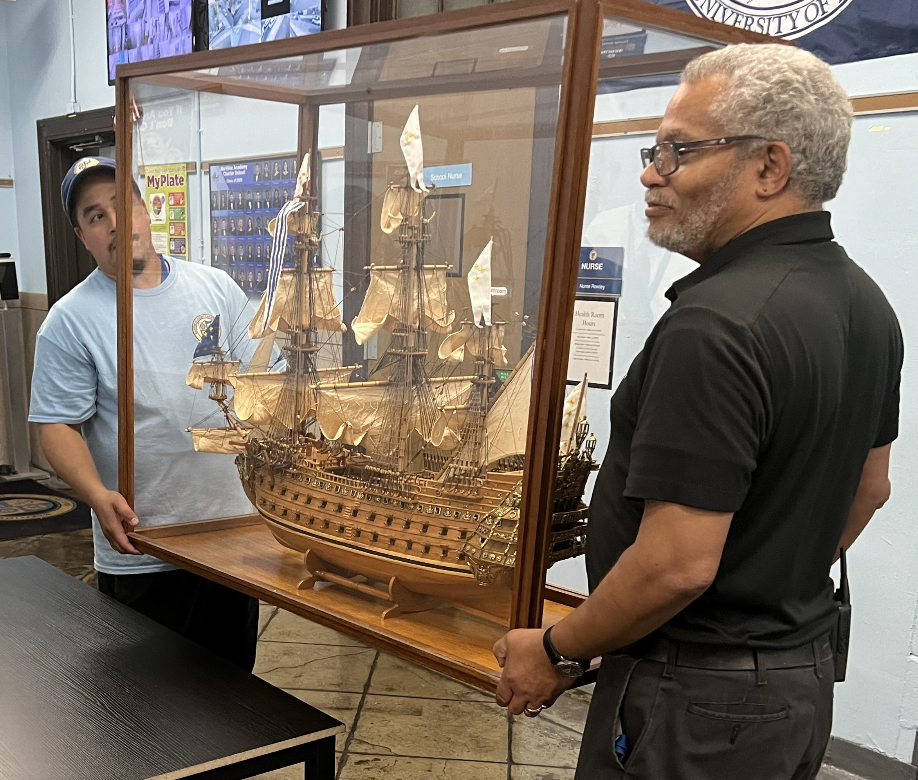
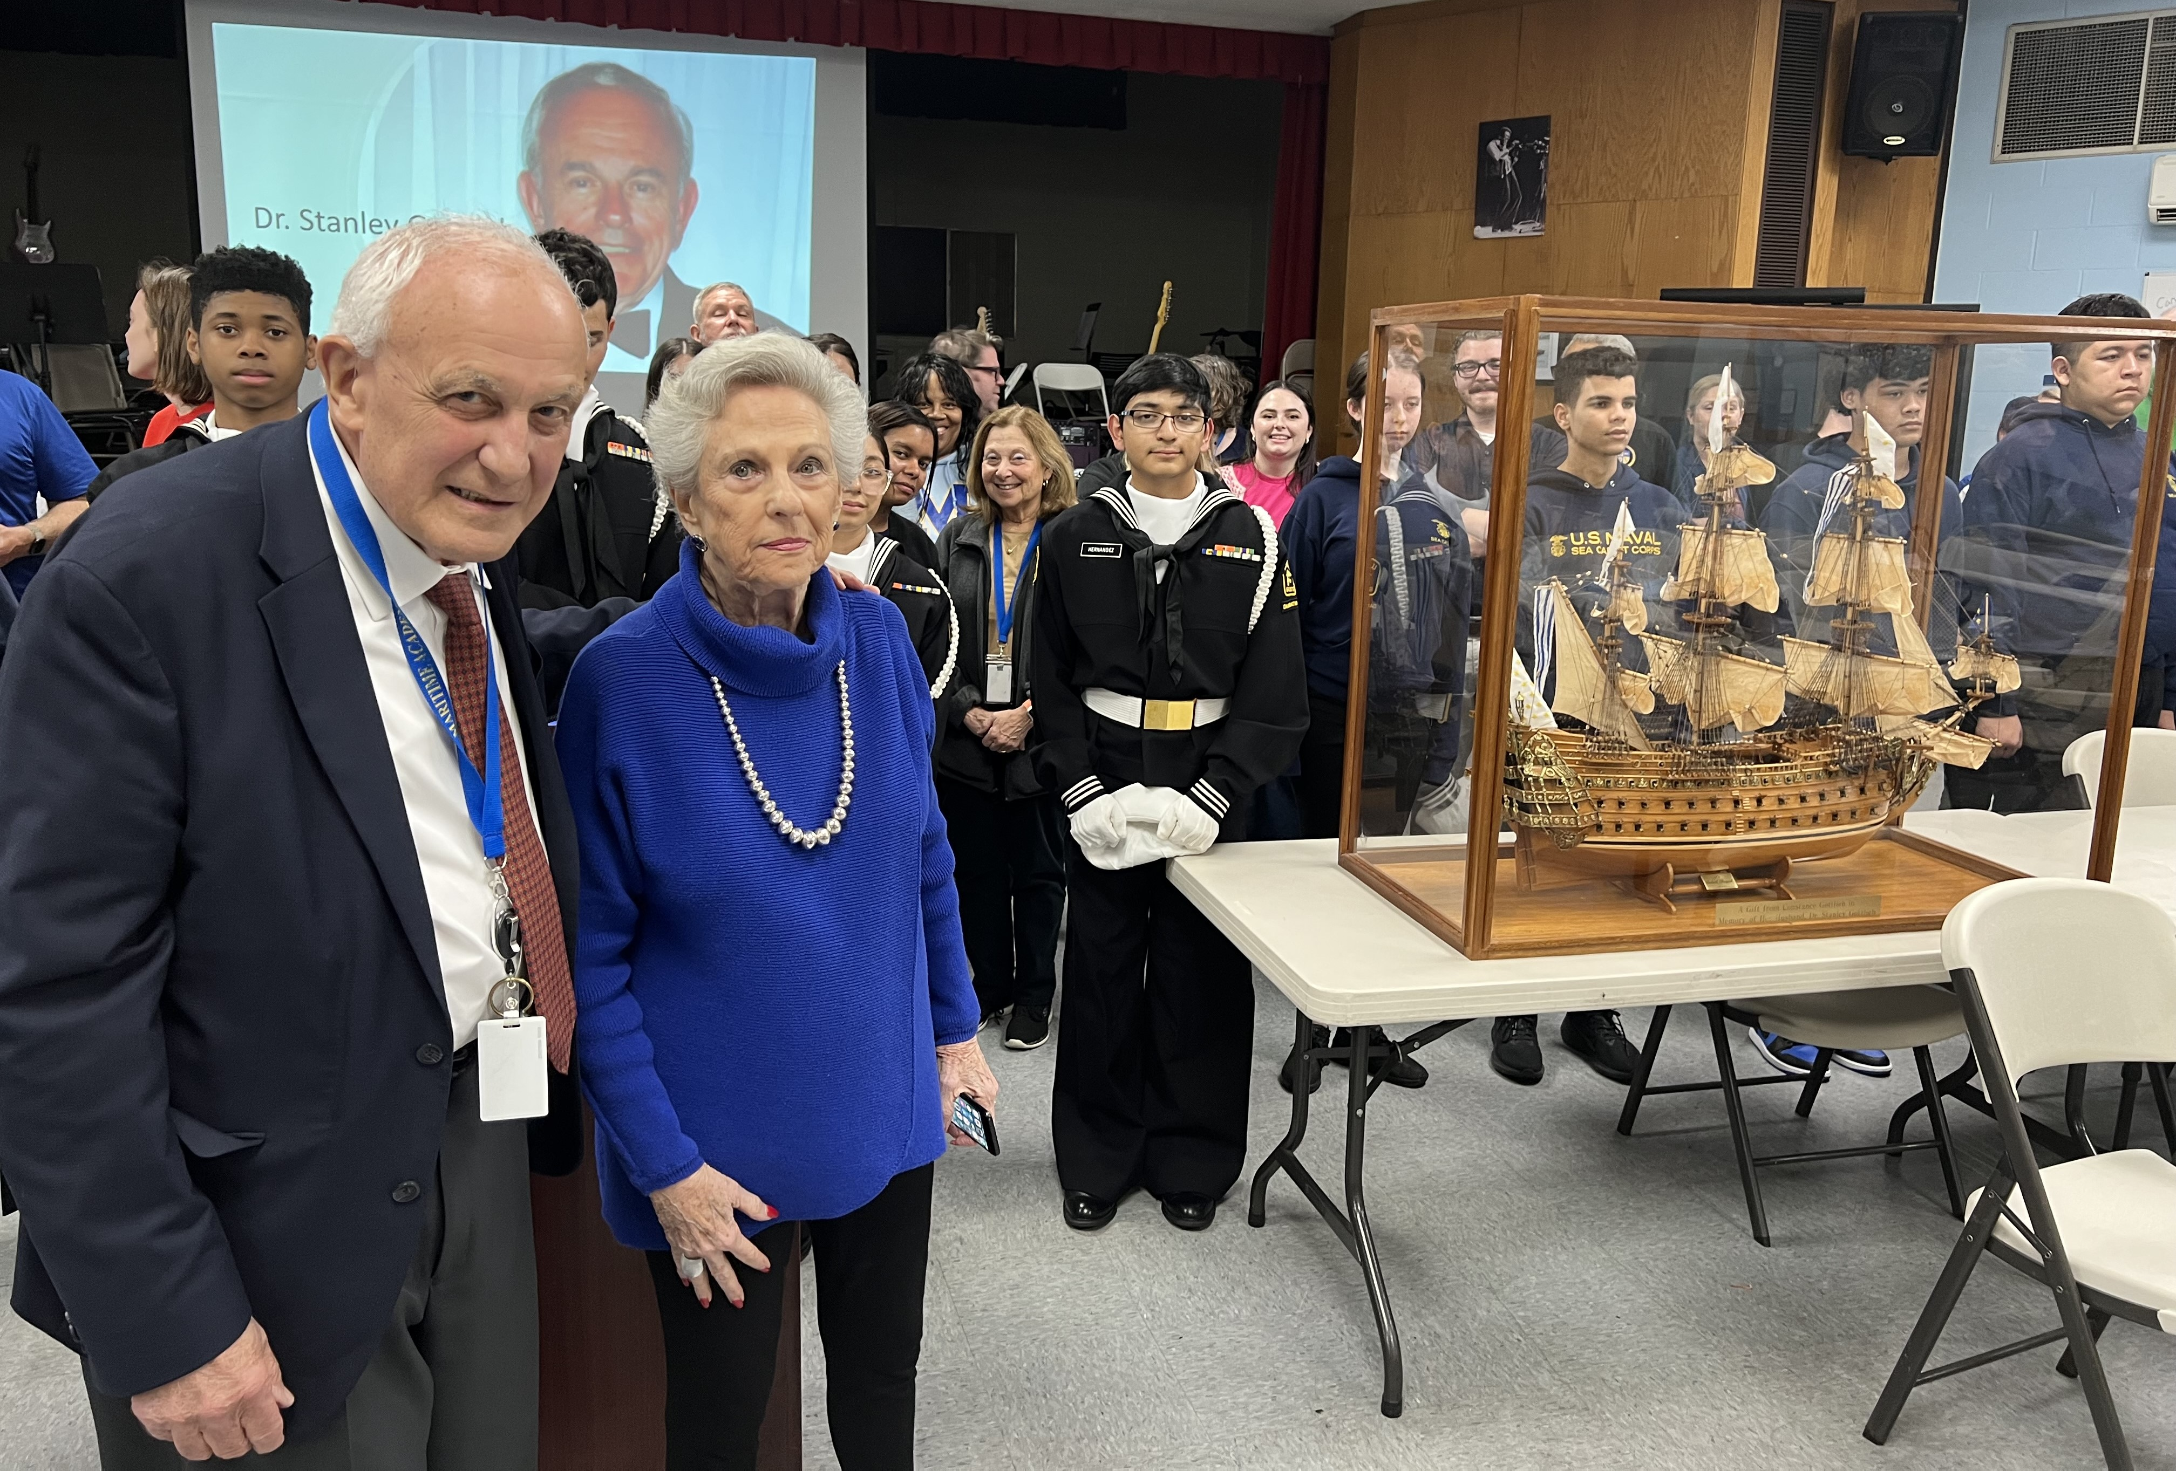
Ship Donation Tribute 11/16/23 In Honor of Stanley Gottlieb with Constance Gottlieb

Slide 10
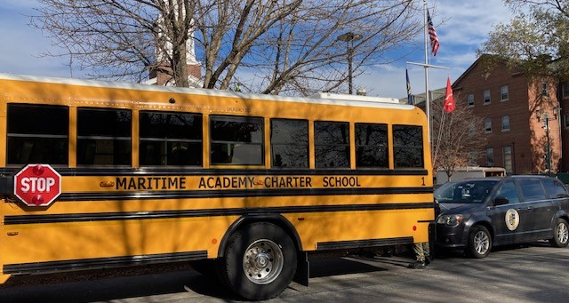
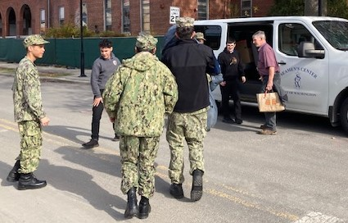
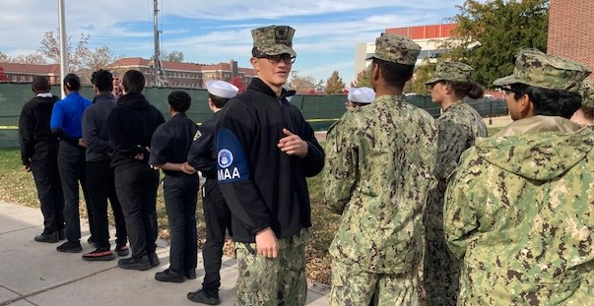
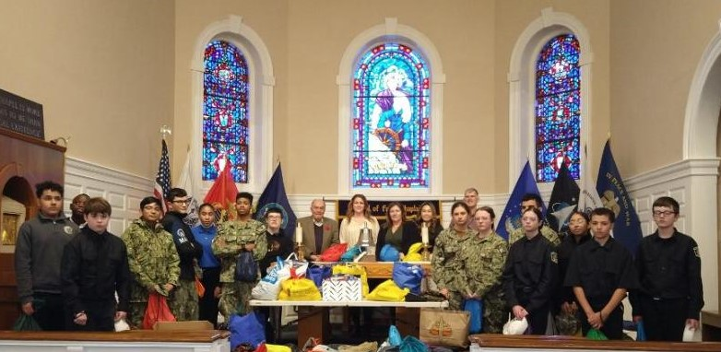
Ditty Bags for SCI and SCW MACS Sea Cadets and League Cadets delivered a large number of ditty bags and socks for seafarers. Thanks to Mrs. Bischoff, Ms. Karnes and crew for their support.

Slide 11
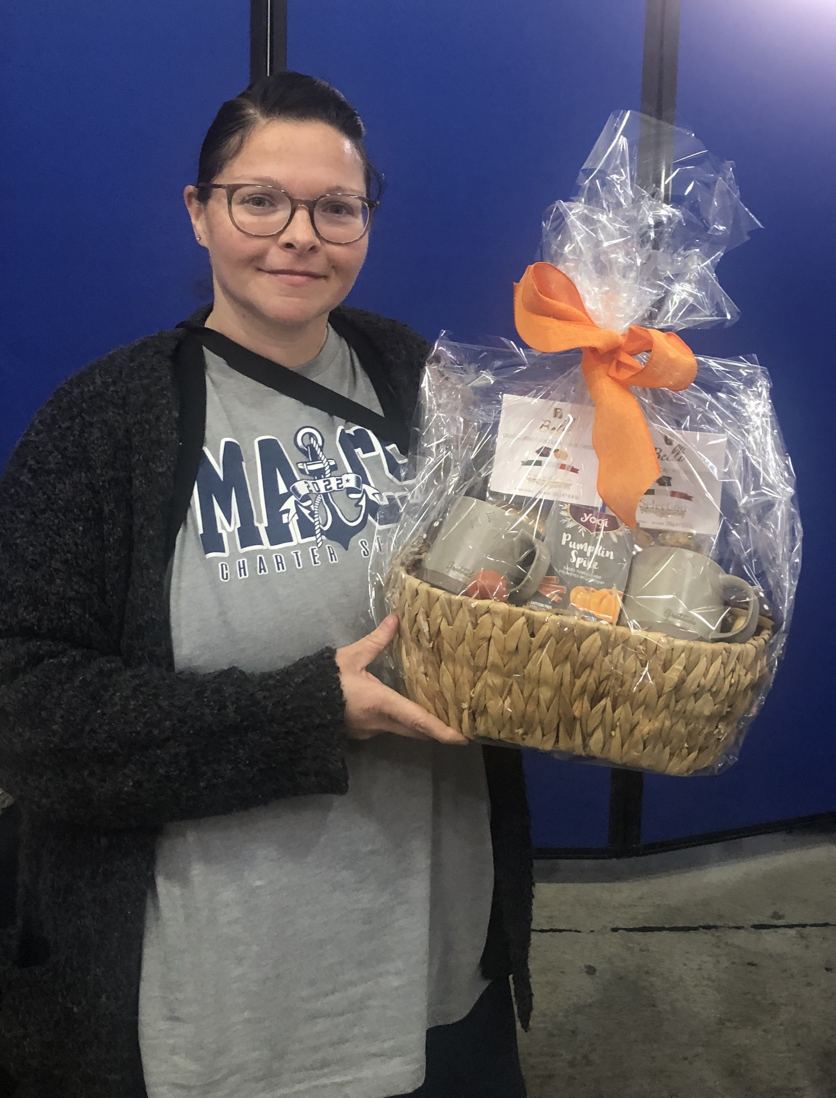
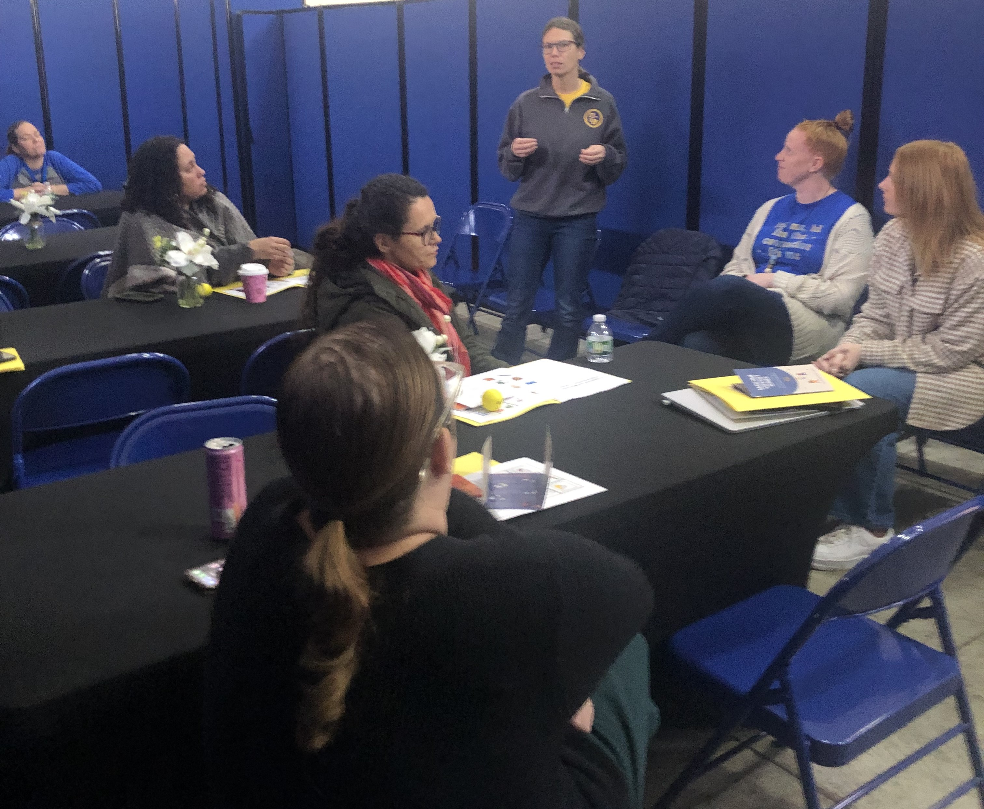
Sip and Speak with Parents 11/17/23

Slide 12
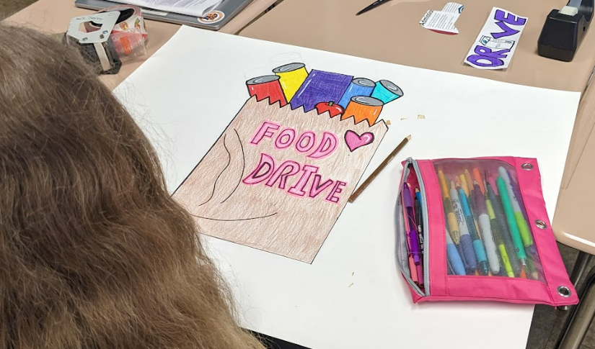
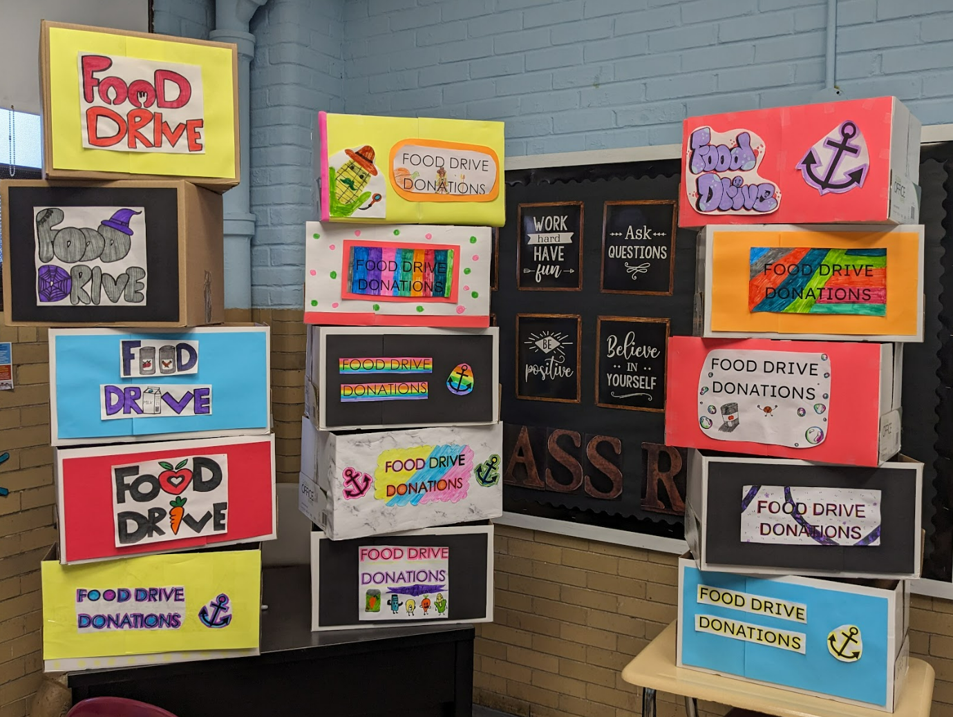
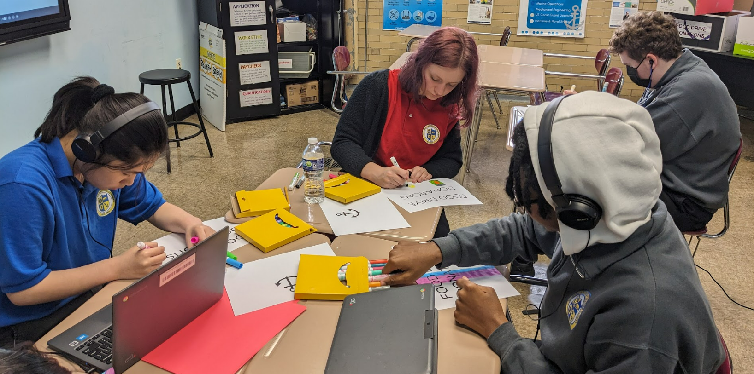
Ms. Pellegrino’s Class Service Learning Project - Food Drive
The students collected 214 items that have been donated to community members in need. Congratulations to Ms. Watts for coming in first place with 113 donated items! Mr. Drain’s advisory took second place and Ms. Simon’s class came in third place!

Slide 13
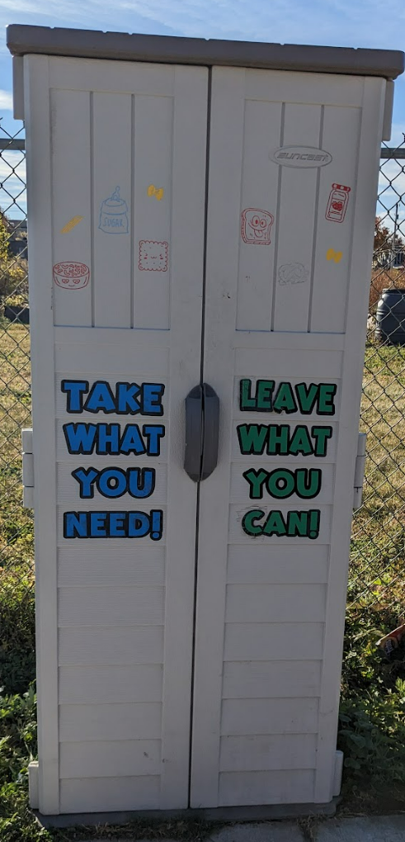
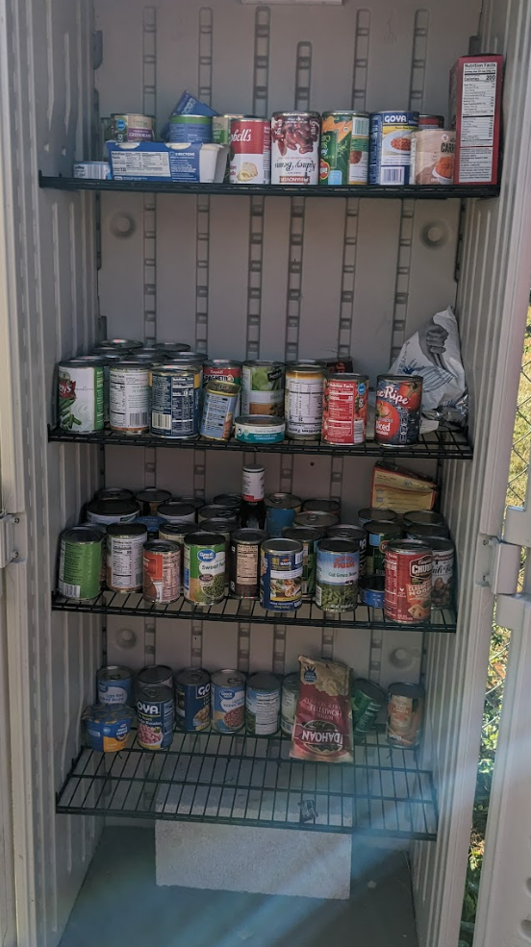
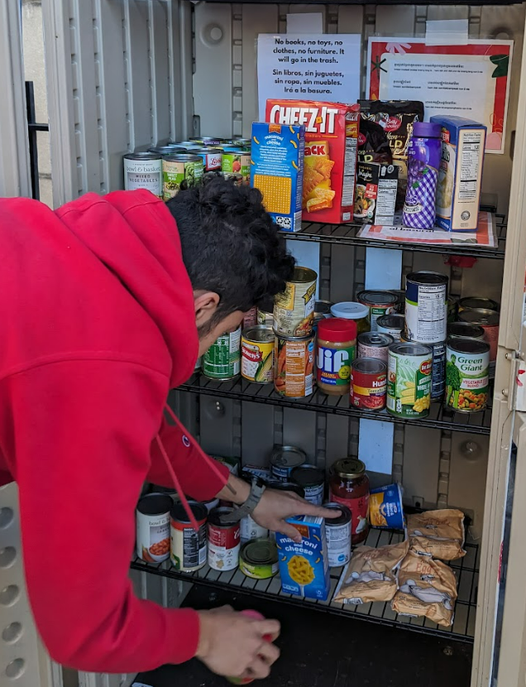
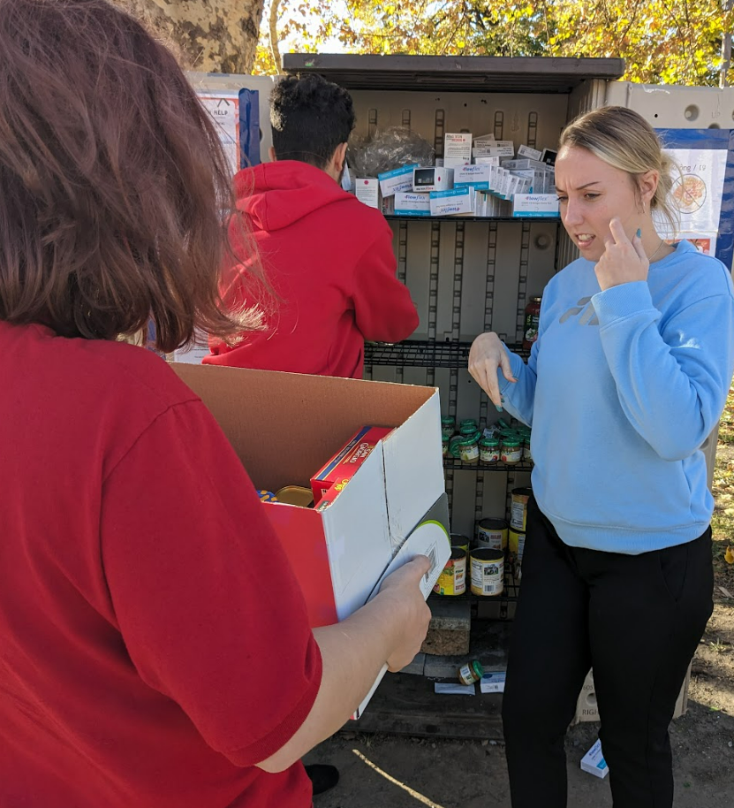
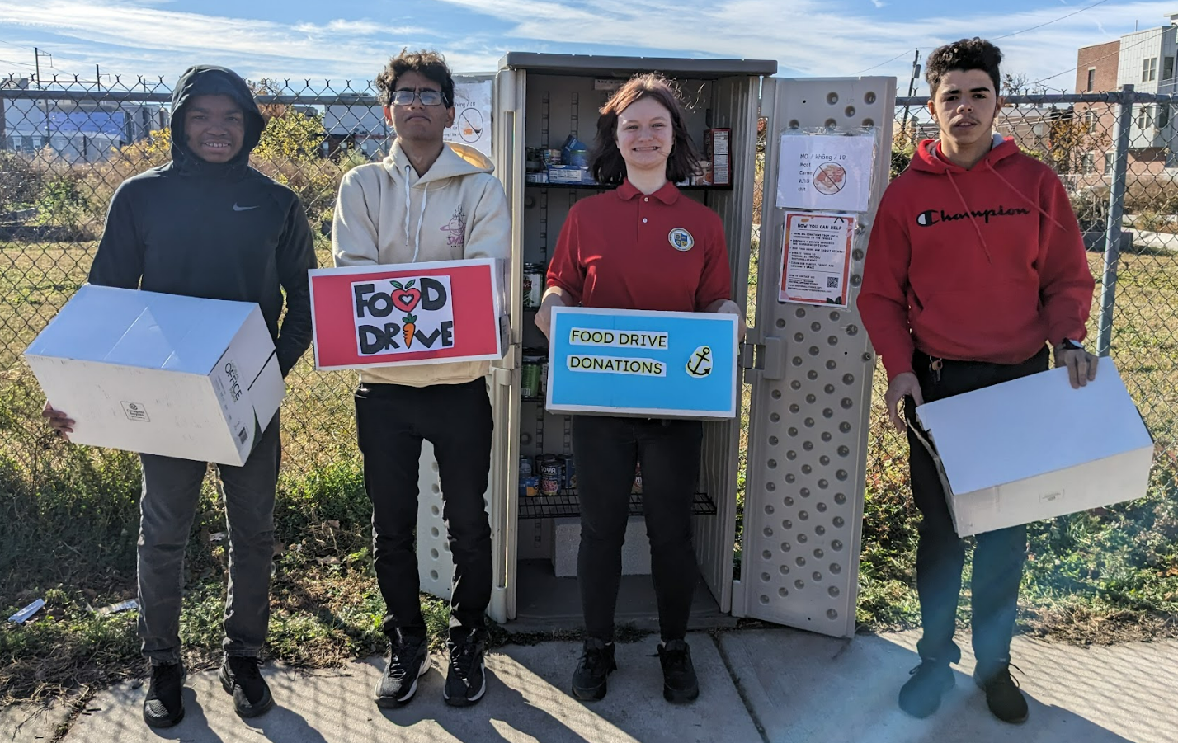
Ms. Pellegrino’s Class Service Learning Project - Food Drive – cont’d
South Philadelphia Community Fridge at the Growing Together Garden:
South Philadelphia Community Fridge at Mifflin Square Park
South Philadelphia Community Fridge at The Bok Building

Slide 14
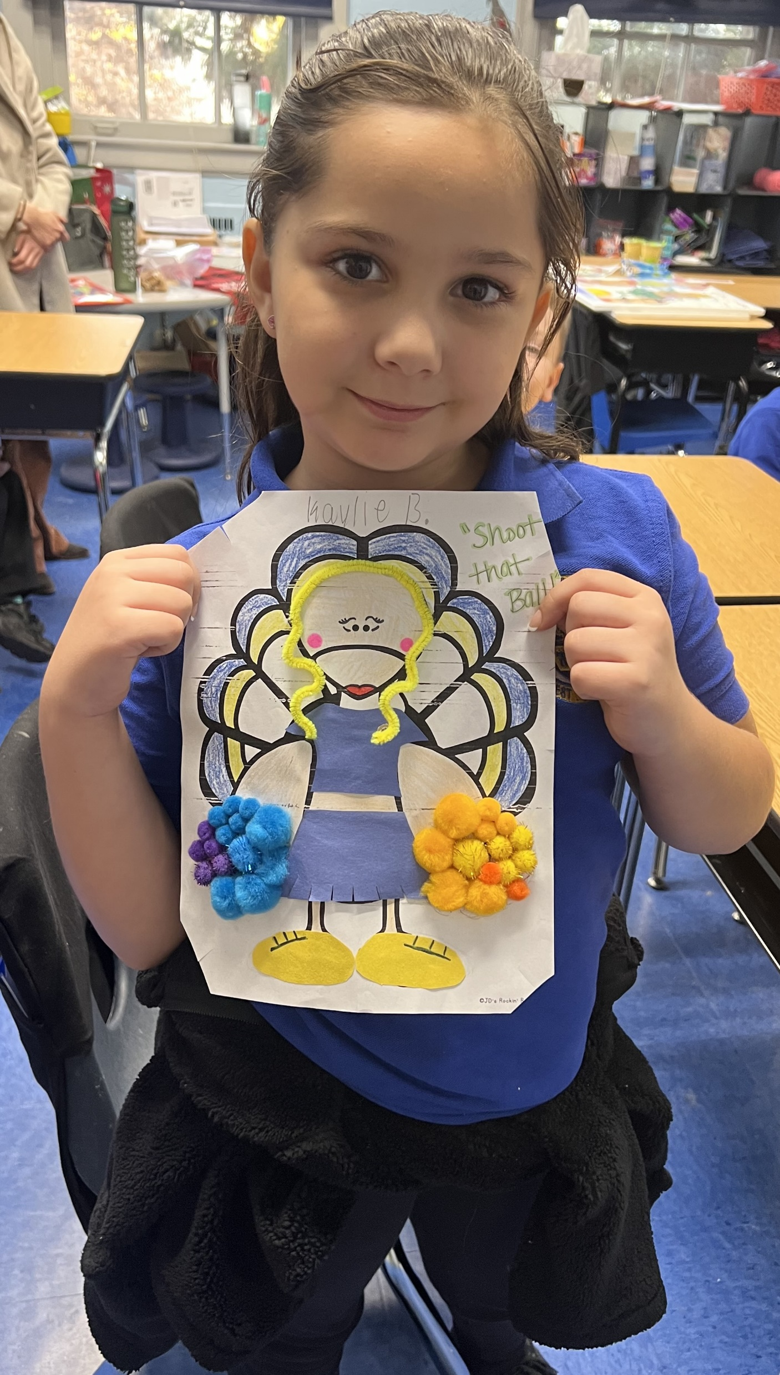
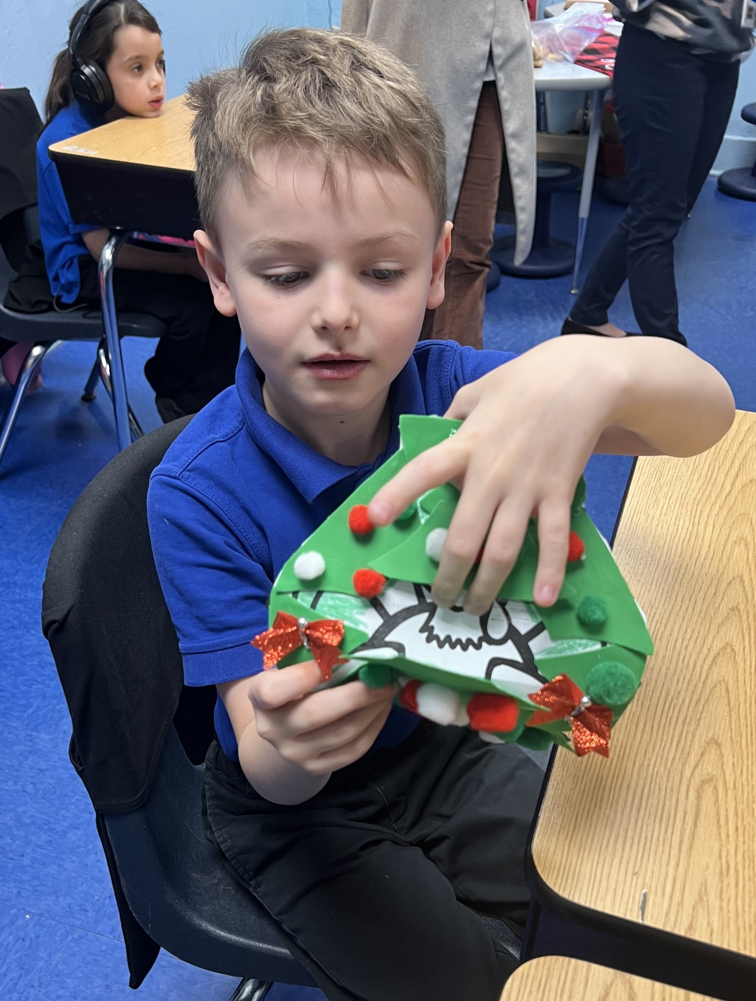
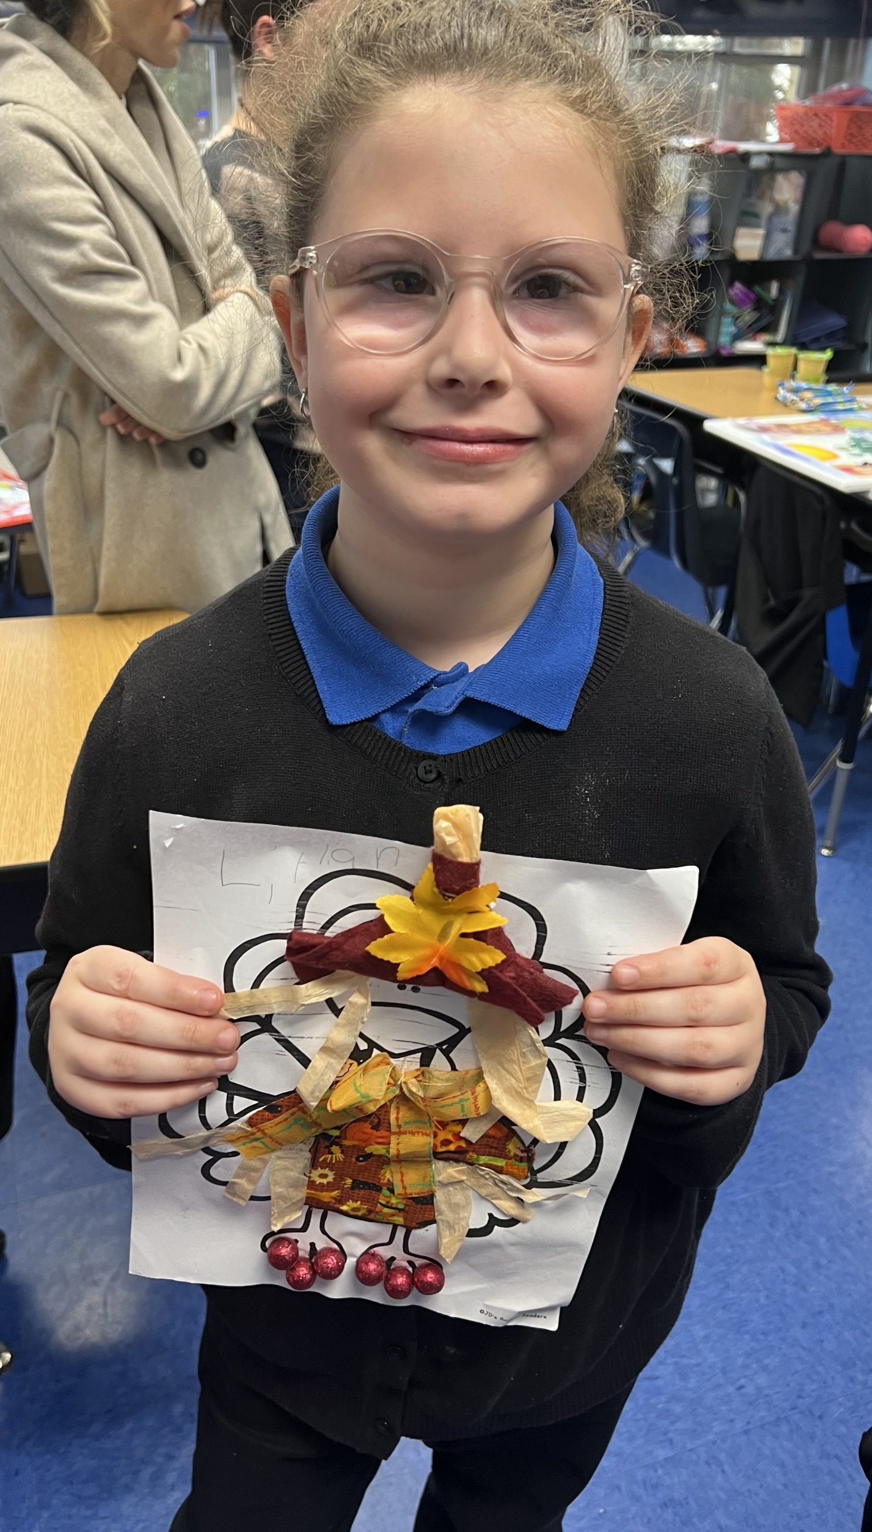
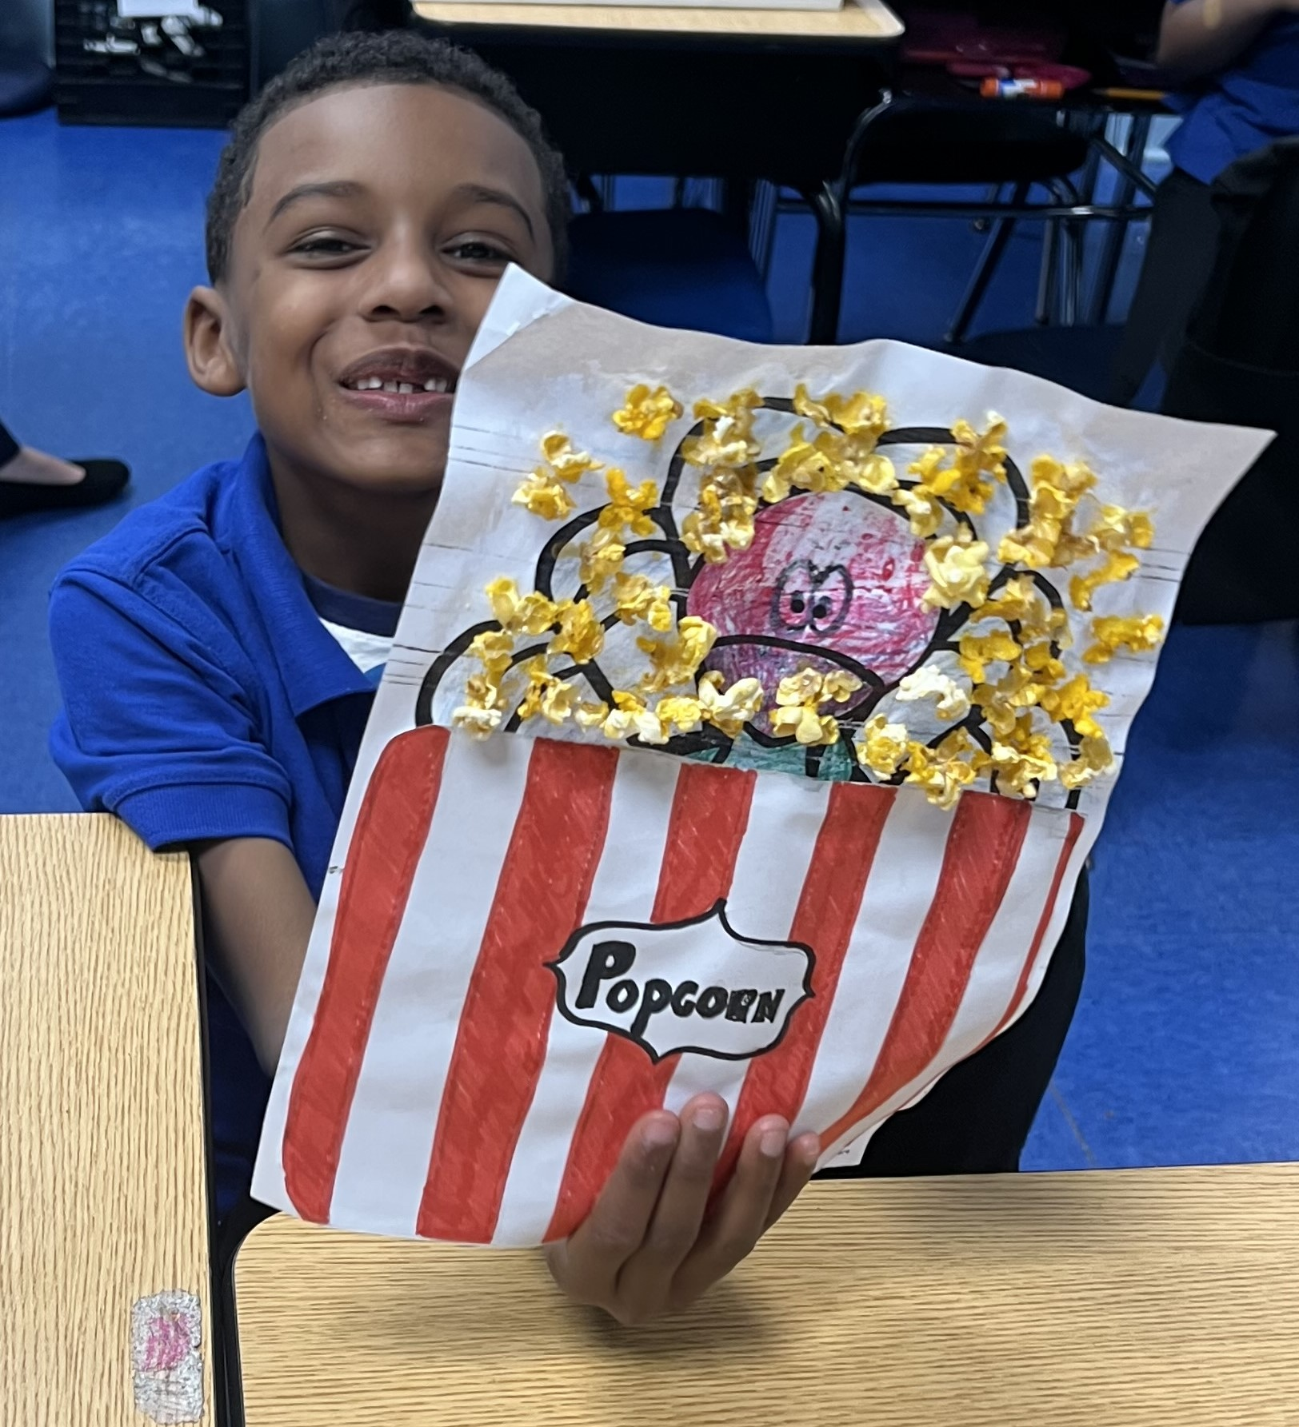
Turkey Day 2023

Slide 15
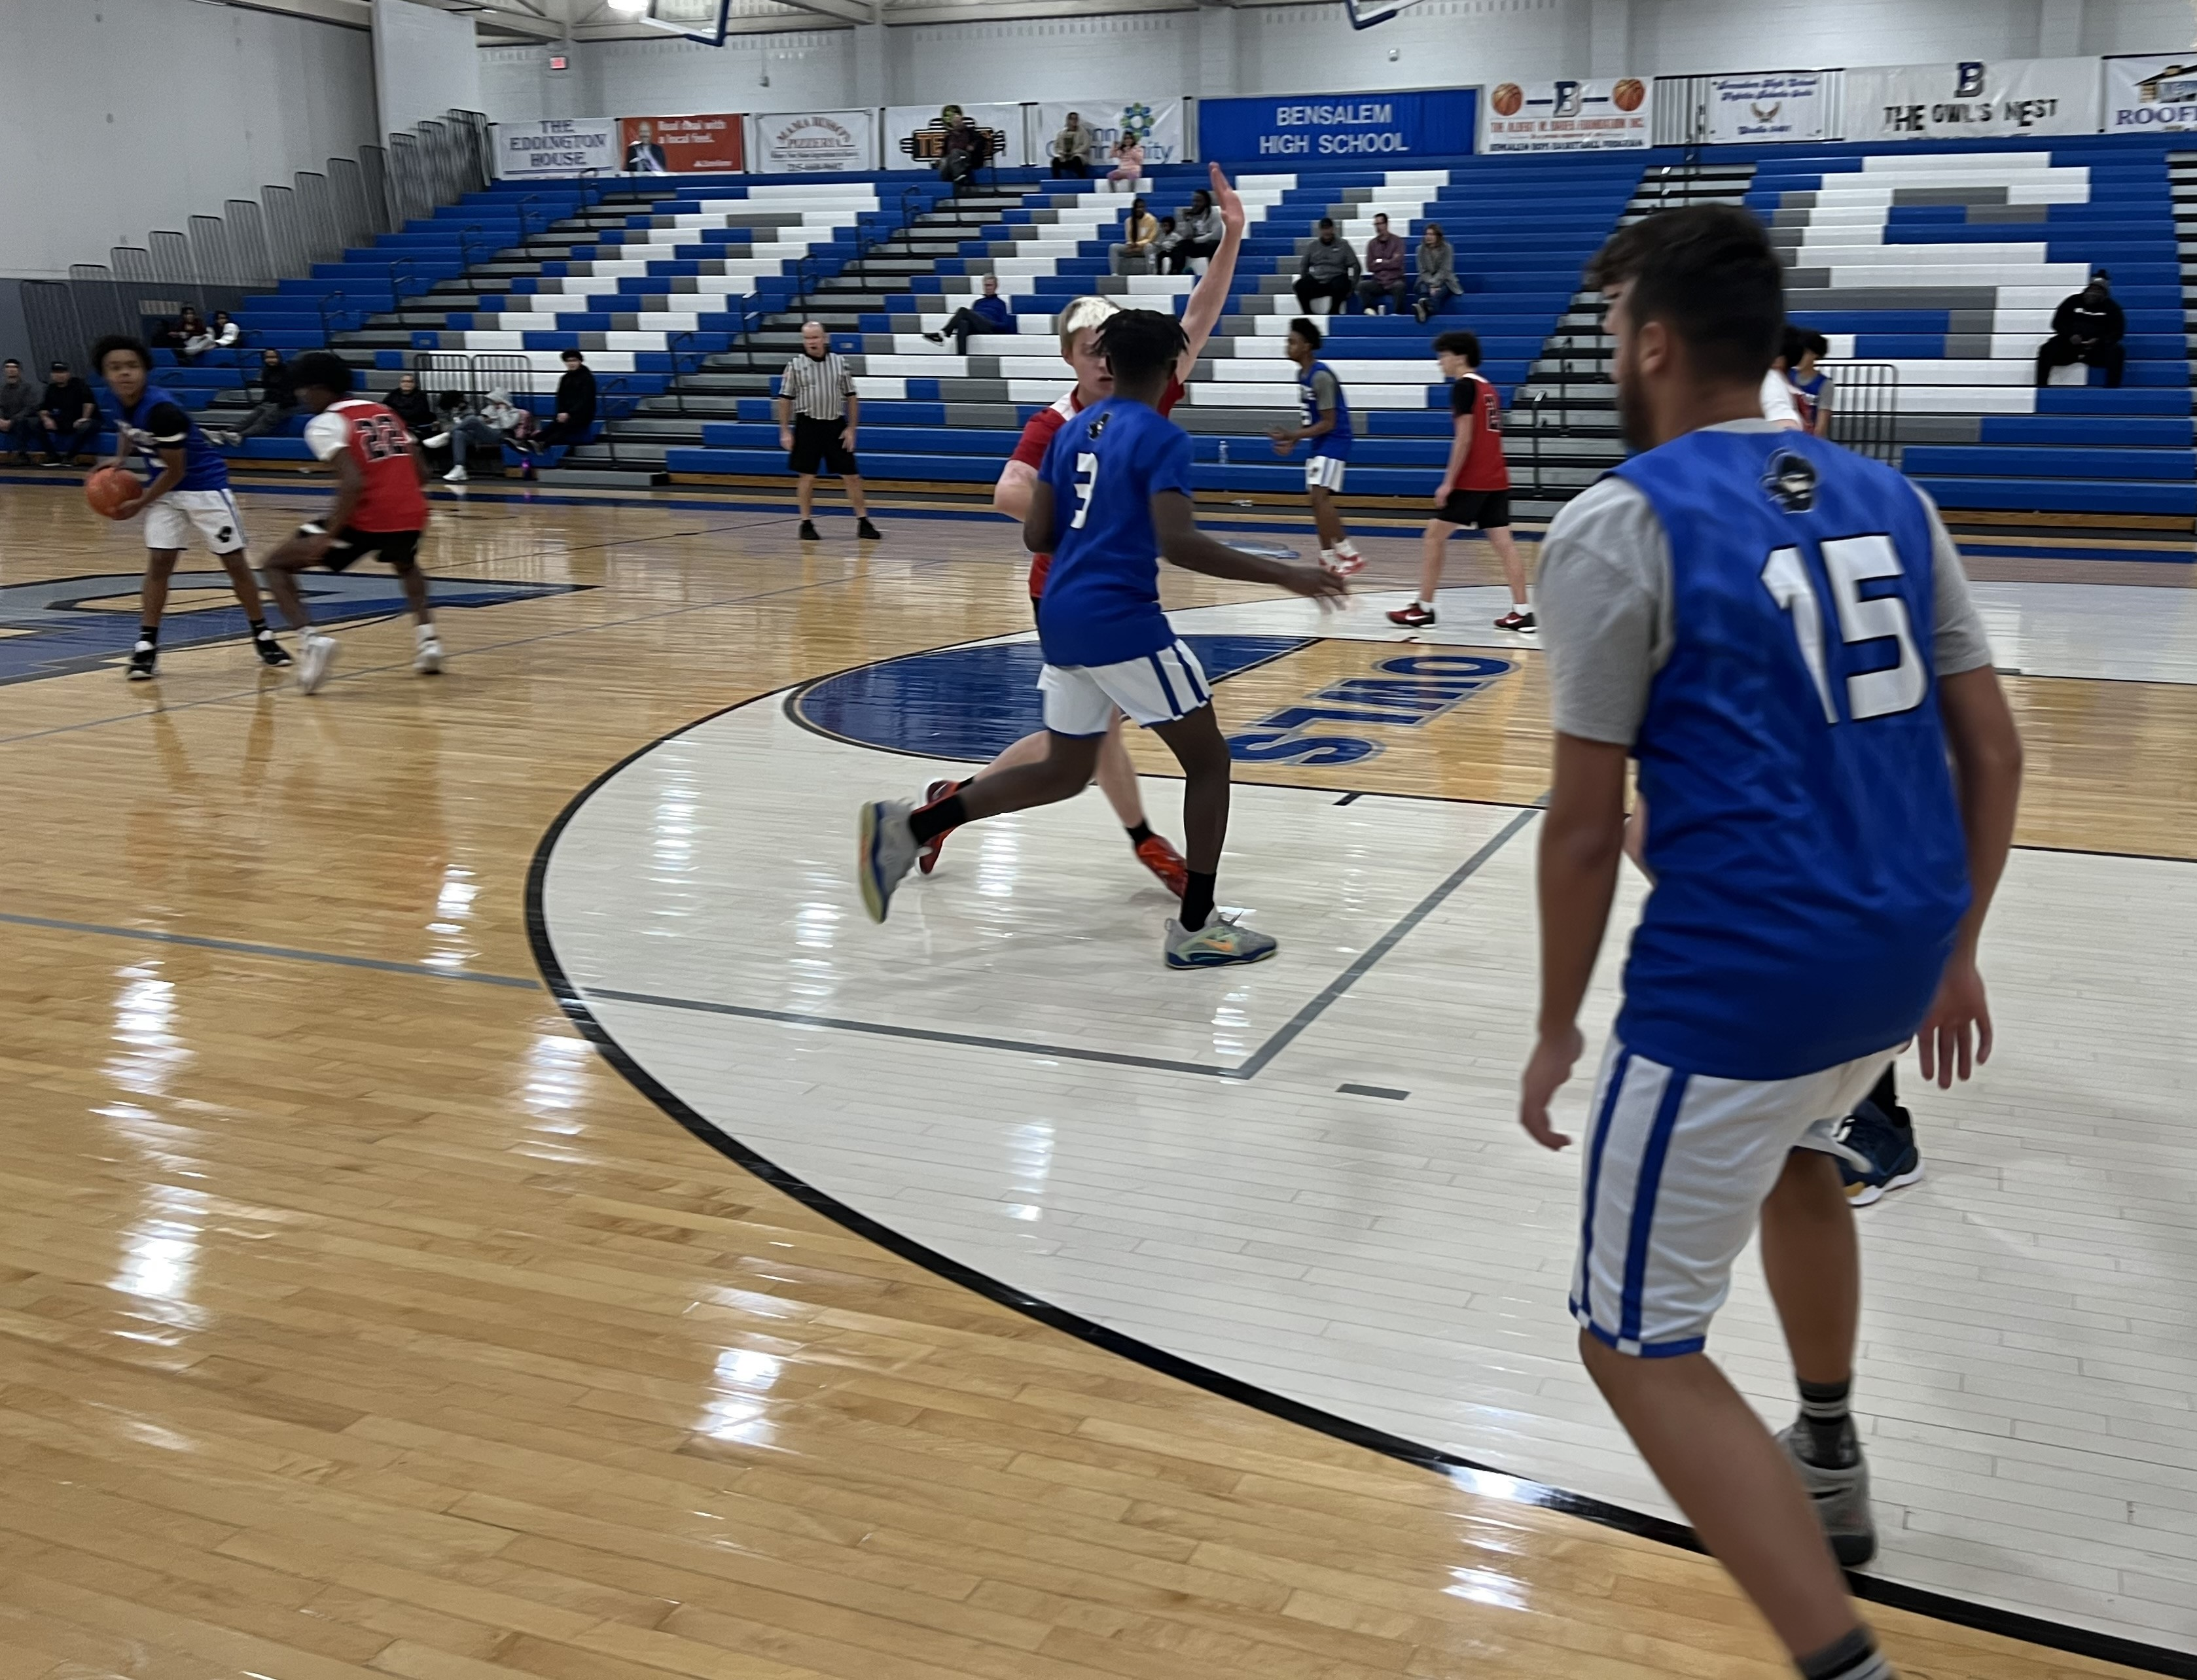
Boys Basketball 11/25/23

Slide 16
National Junior Honor Society 11/28/23

Slide 17
Cadet of the Month 11/29/23

Slide 18
Ship Donation by Louise Marshall-Kelly Lord Nelson’s HMS Victory

Slide 19
NAMEPA Poster Contest Winners 11/30/23
Joanna Mok and Elissa Ledvon

